Slide 1
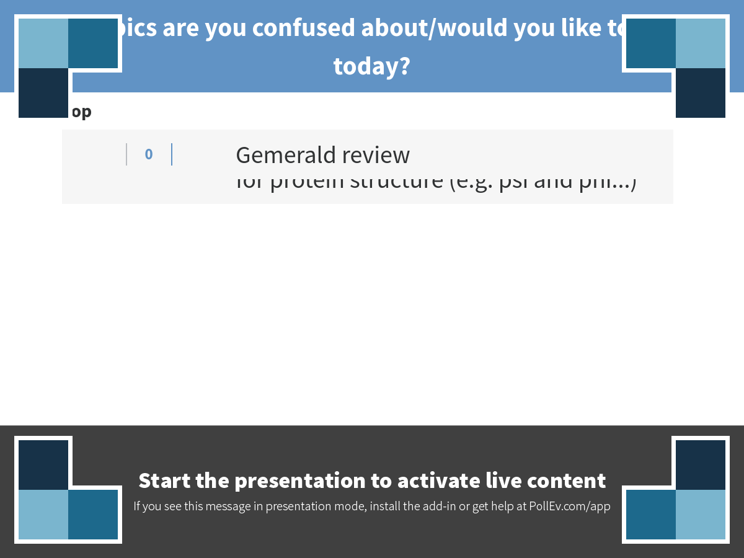
Notes:
What topics are you confused about/would you like to go over today?
https://www.polleverywhere.com/discourses/r7BmzKwtqPECRfd

Slide 2
Topics to review
Gene cloning
CRISPR-Cas9

Slide 3
Broad topics
The basics of genetic information flow and the genetic code
The chemical basis of nucleic acid and protein structure and function
PCR
Cloning
Genome structure
DNA replication
Methods for genetic engineering/genome modification/genome editing including CRISPR-Cas9

Slide 4
Broad topics cont’d
Methods for DNA sequencing
Methods for measuring gene expression
Telomeres and telomerase
DNA damage and repair
Homologous recombination
Transcription and RNA processing
Translation
Regulation of gene expression

Slide 5
The flow of genetic information: be prepared to diagram it

Slide 6
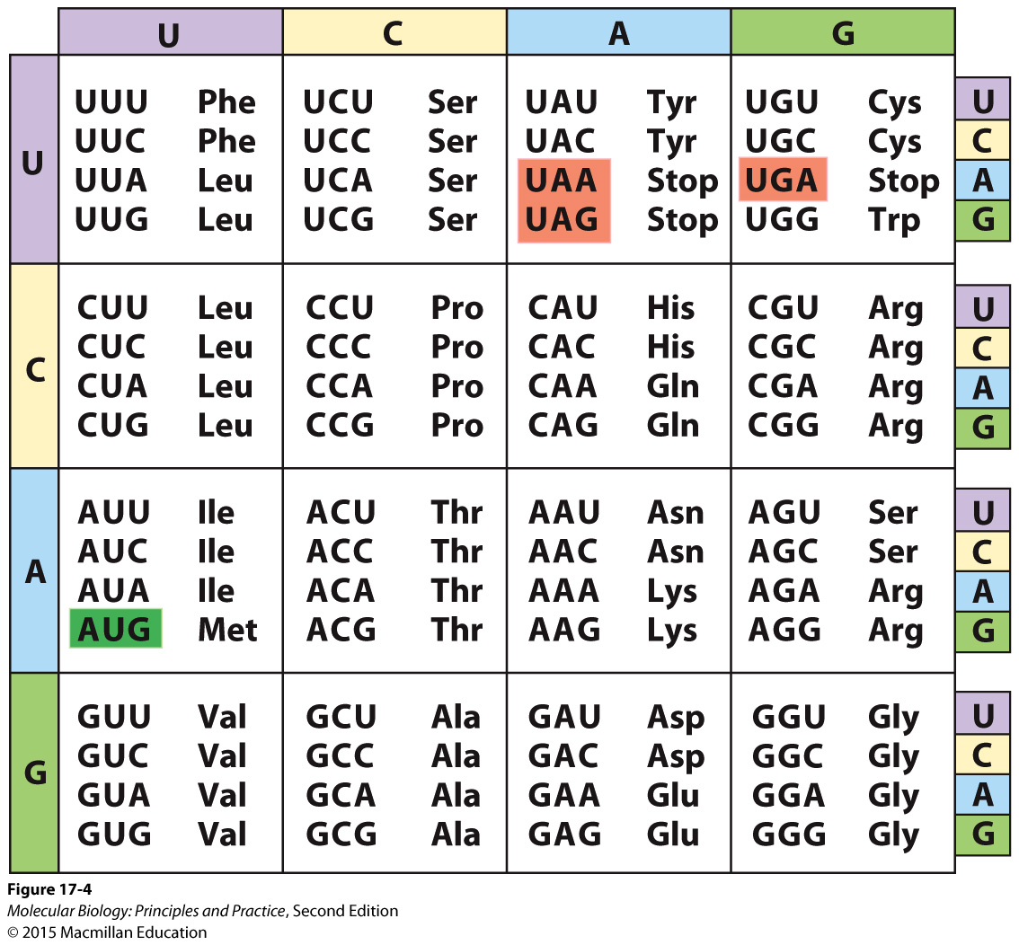
The genetic code: be prepared to translate any sequence you are given

Slide 7
The effect that mutations may have on gene function and why
Base/nt changes
Insertions or deletions

Slide 8
Enzymes and enzymatic activities that you should know (in no particular order, and not an exclusive list)
Reverse transcriptase
DNA polymerases I and III
DNA helicase
Restriction endonuclease
Endonuclease
Exonuclease
Topoisomerase
DNA ligase

Slide 9
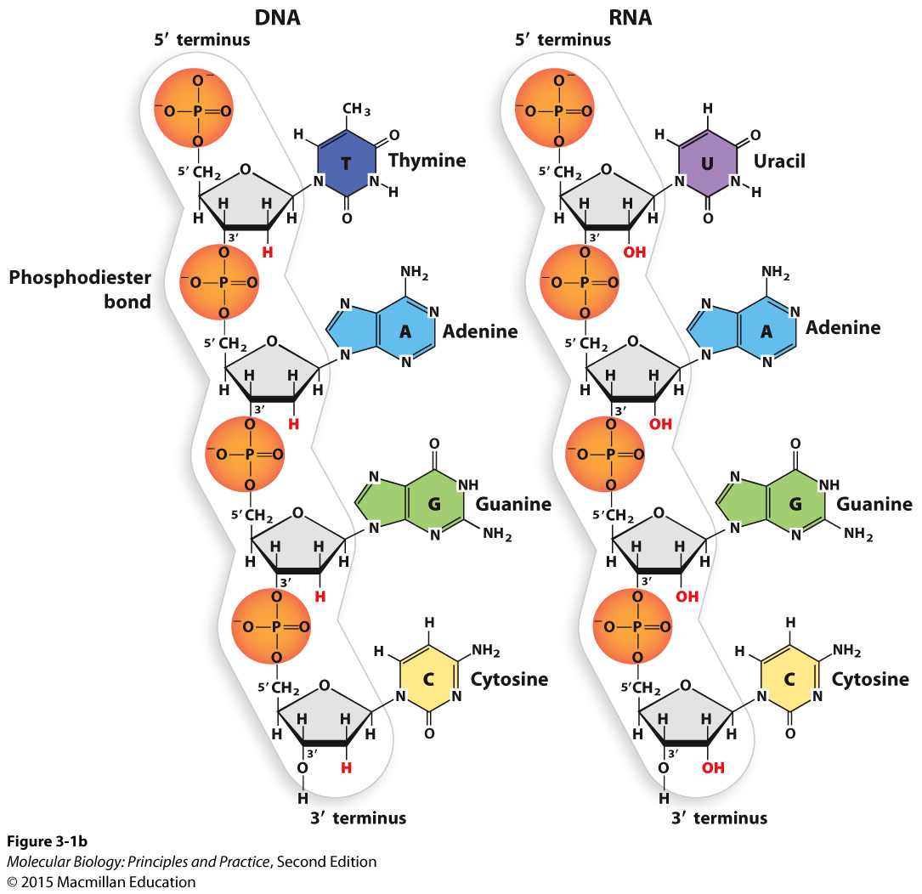
The chemical structures of nucleic acids
Be prepared to draw the chemical structure of a DNA or RNA backbone (don’t need to know base structures)
Identify 5’ and 3’ ends, 5’, 2’, and 3’ carbons, 2’ and 3’ OHs
Identify phosphodiester linkage
Identify ribose or deoxyribose, phosphate group, hydroxyl group(s)
Know differences between DNA and RNA

Slide 10
Bonds, forces, and effects that mediate interactions within and between molecules
Covalent bonds
Hydrogen bonds (H-bonds)
Ionic bonds
van der Waals forces
Hydrophobic effect
Stacking (comprised primarily of van der Waals and hydrophobic forces)

Slide 11
Nucleic acid structure cont’d
Primary and secondary structure, and the types of bonds that underlie them.
The bonds/forces/effects that cause double-stranded nucleic acids to form double helices.
The effects of the 2’ OH on RNA structure and function:
RNA is less stable than DNA due to the ability of the 2’ OH to carry out a nucleophilic attack on the phosphate (especially in alkaline conditions)
RNA can form a wider range of 3-dimensional structures because the 2’ OH can hydrogen bond with other atoms (intramolecular or intermolecular)
The 2’ OH changes the shape of the sugar
The 2’ OH can also mediate interactions with proteins

Slide 12
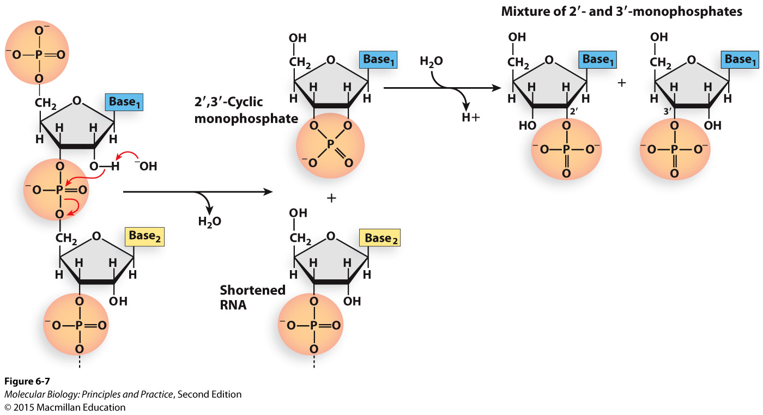
Spontaneous hydrolysis of RNA in basic conditions
The 2’ OH is deprotonated
The 2’ O carries out a nucleophilic attack on the phosphorus in the phosphate group
The phosphodiester linkage is broken, leaving a 5’ OH on one fragment and a phosphate linked to both the 2’ and 3’ carbons of the other fragment.
The unstable cyclic structure resolves to give a 2’ or 3’ phosphate.

Slide 13

Nucleophilic attacks and hydrogen bonding make sense when you consider which atoms will have partial negative and partial positive charges as a result of unequal sharing of electrons
Elements forming bond | Distribution of charge
Oxygen and hydrogen
Carbon and hydrogen
Nitrogen and hydrogen
Oxygen and carbon
Oxygen and phosphorus

Slide 14
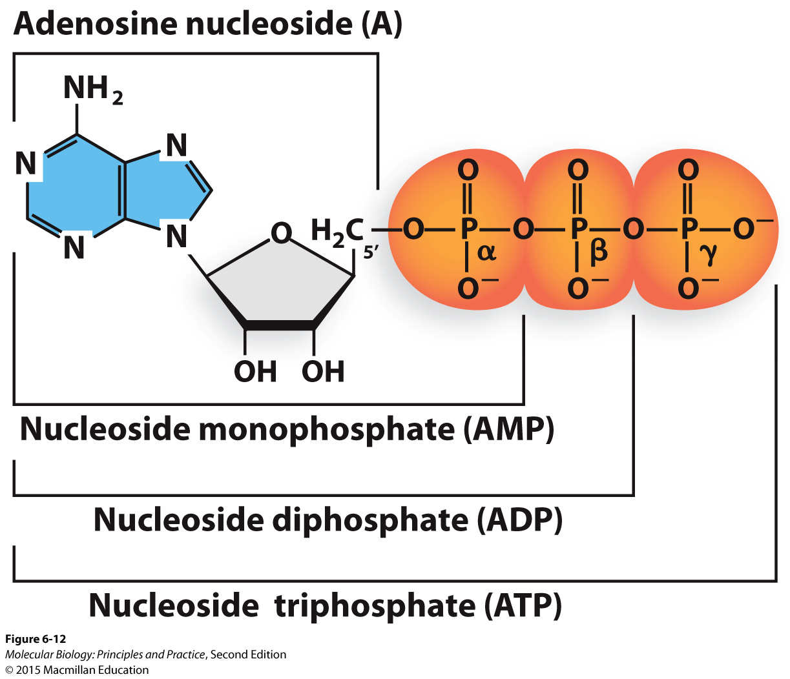
Nucleotides and nucleotide structure
Be prepared to tell me the composition of a given nucleotide (example: dGTP is a nucleotide composed of a guanine base, deoxyribose, and a 5’ triphosphate).
Be prepared to give the abbreviation for a given nucleotide.
What is the difference between a nucleotide and a base?

Slide 15
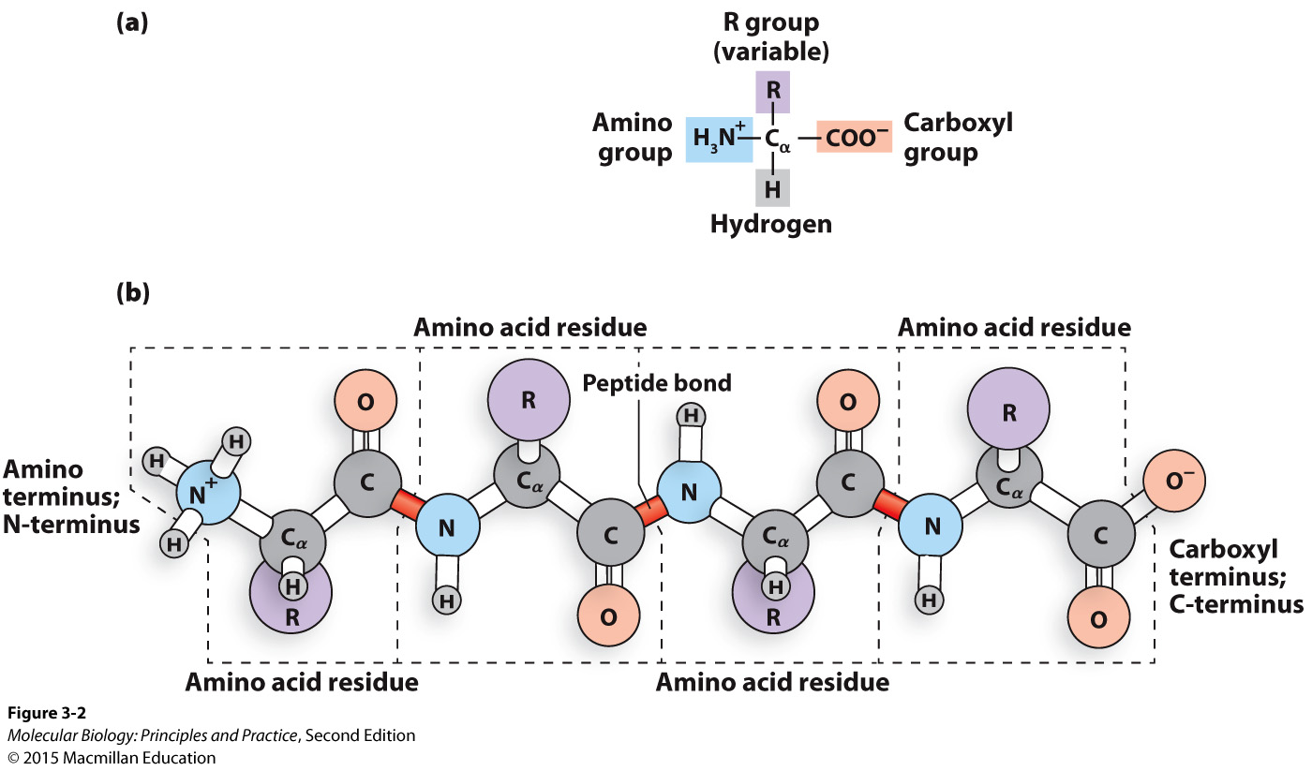
Protein/peptide/polypeptide structure

Slide 16
Protein/peptide/polypeptide structure
Be prepared to draw the chemical structure of a peptide backbone (with amino acid side chains indicated by “R”)
N and C termini
Peptide bonds
Residues (amino acids)
Know the bonds/forces/effects that mediate interactions between protein backbone atoms and atoms in the same protein/other proteins/other molecules
Know the bonds/forces/effects that mediate interactions between protein side chain atoms and atoms in the same protein/other proteins/other molecules
Given the chemical structure, indicate if an amino acid side chain is polar uncharged, non-polar, aromatic, or polar charged, and if it’s likely to interact with other molecules through covalent bonds, hydrogen bonds, ionic bonds, hydrophobic effects, and/or stacking interactions.

Slide 17
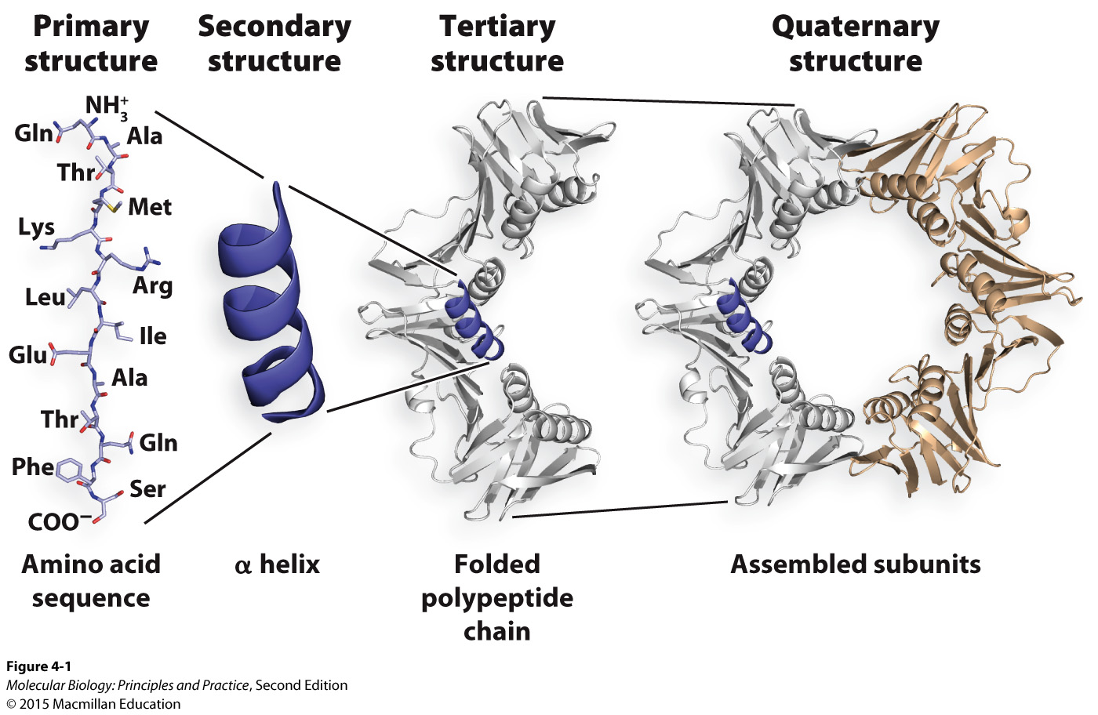
Protein/peptide/polypeptide structure cont’d
Define the four levels of protein structure, and describe the bonds/forces/effects responsible for each one.

Slide 18
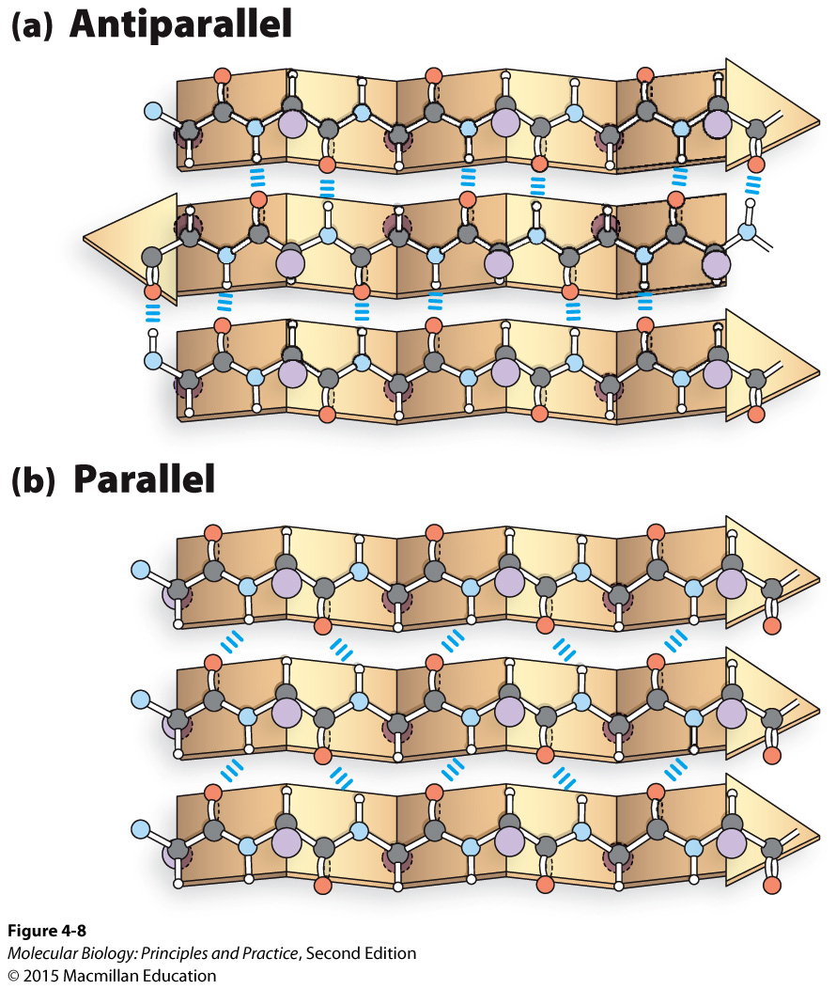
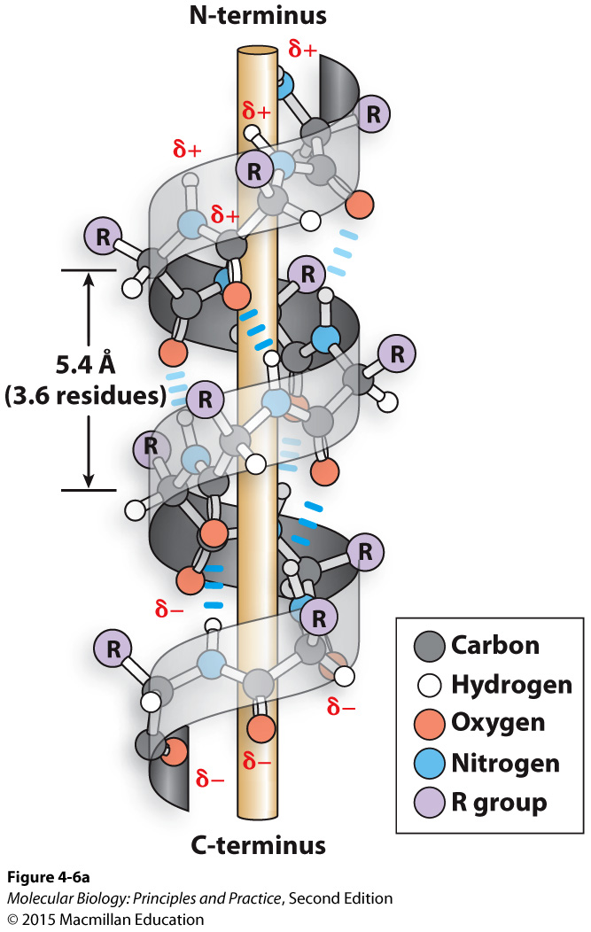
Protein/peptide/polypeptide structure cont’d
Alpha helices and beta sheets: describe the bonds that hold these together, and the respective roles of side-chain and backbone atoms.

Slide 19
Interactions between proteins and nucleic acids
Sequence-specific interactions involve direct molecular contact with the bases in the nucleic acid
Hydrogen bonds between bases and the protein
Non-sequence-specific interactions involve contact with atoms in the backbone of the nucleic acid, and non-specific interaction with bases such as stacking.

Slide 20
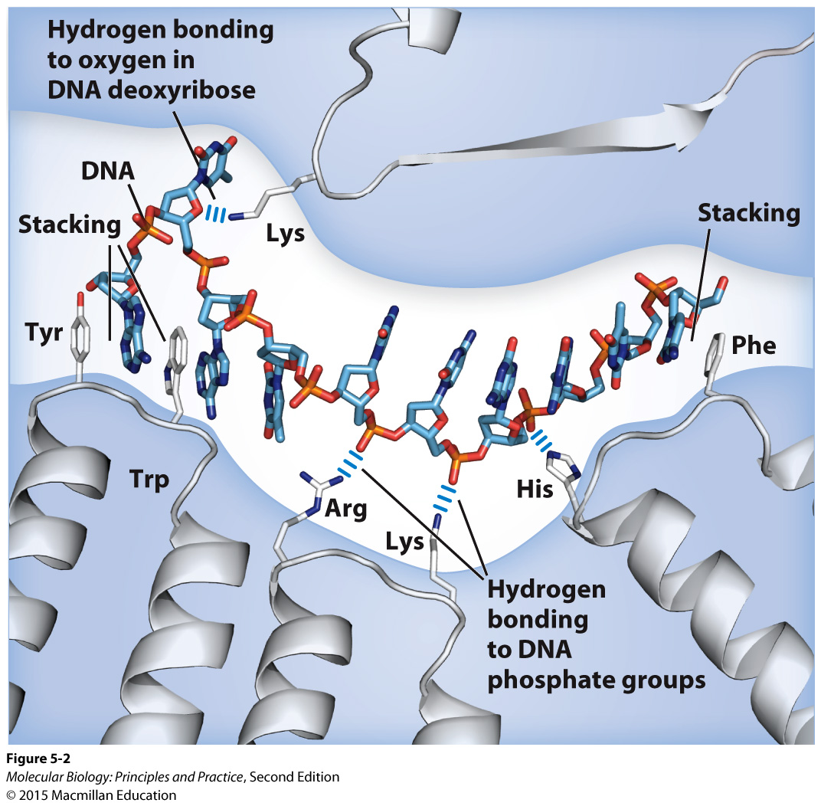
Examples of non-sequence-specific interactions between a single-stranded nucleic acid and a protein
Note that ss and ds nucleic acids will not bind to the same binding pocket (DNA binding proteins are usually structure-specific)

Slide 21
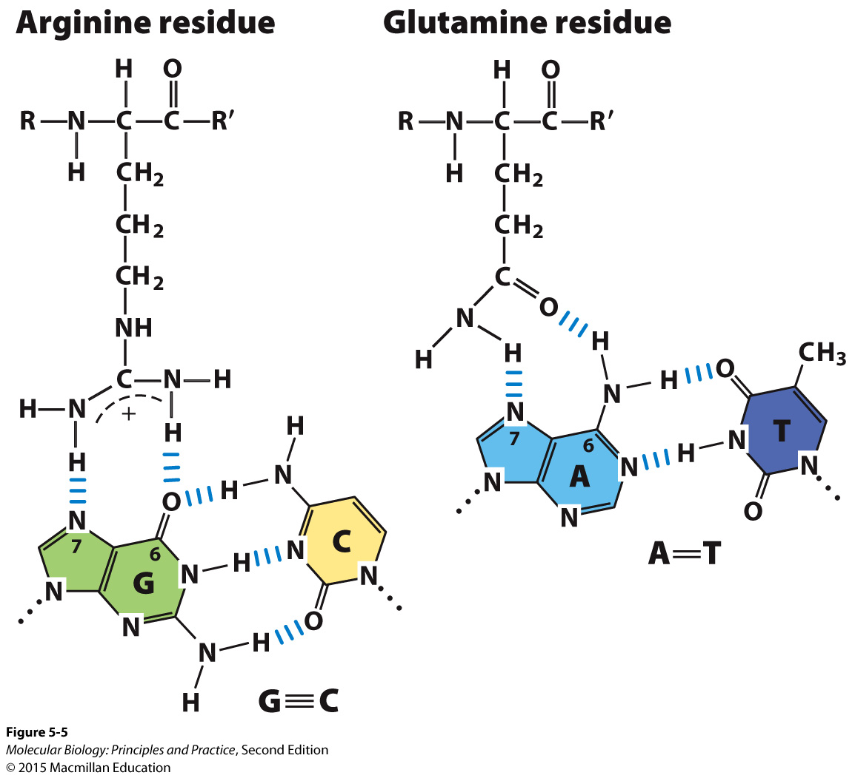
Examples of sequence-specific interactions between bases and amino acids
The bases are most often accessed at the major groove

Slide 22
PCR
What does it do, how does it do it, and why it is useful?
Know what components you need, and what the role of each one is.
Be prepared to design primers for any given template DNA sequence.
Be prepared to identify the sequence that will be amplified by a given set of primers.
Be prepared to design primers that will add additional sequences not present in the template.

Slide 23
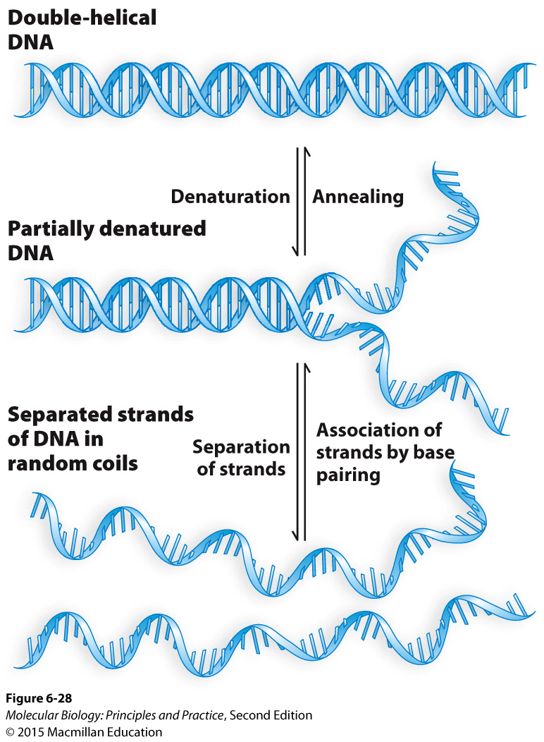
PCR
Understand annealing, denaturation (aka “melting”), Tm, and the significance of these for PCR.

Slide 24
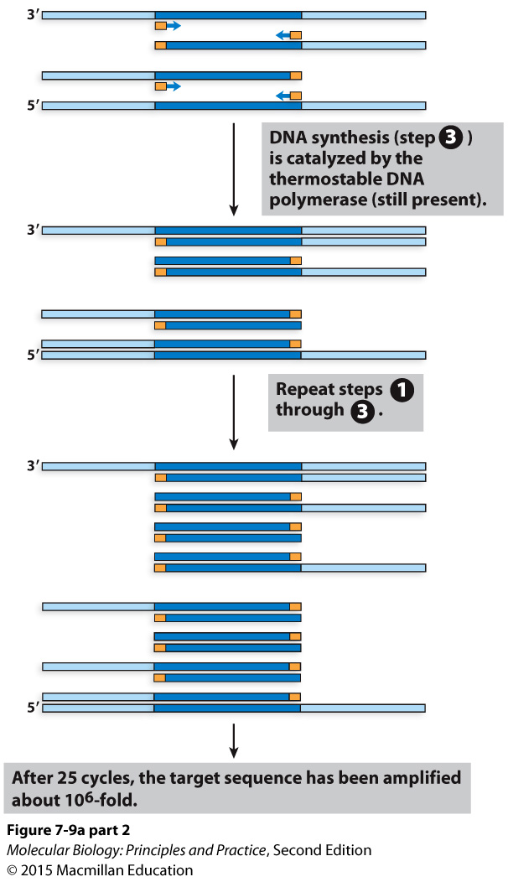
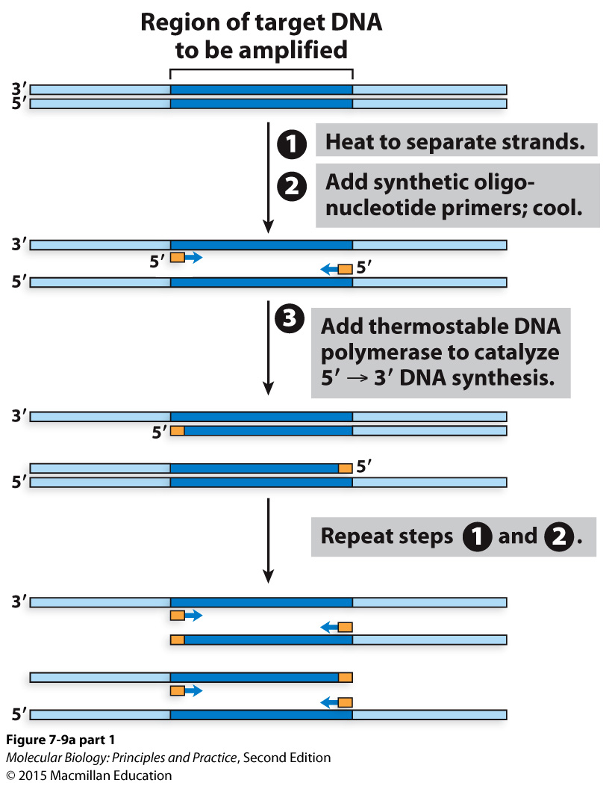
PCR diagramed

Slide 25
Cloning
What is it and why is it useful?

Slide 26
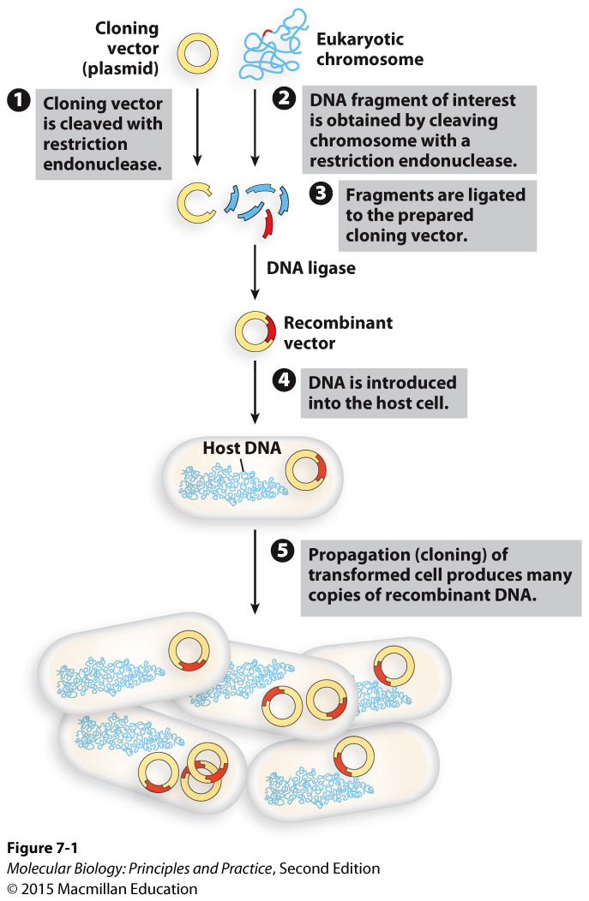
An overview of cloning with restriction enzymes (aka restriction endonucleases)
Or PCR with primer tails to add restriction sites – be prepared to design these
Putting DNA into a bacterium is transformation
For cloning, this is usually E. coli
Select on media containing drug to which the plasmid confers resistance
Isolate the plasmid and sequence it to confirm it’s correct, then:
Move it into an organism of interest (think of an example!)
Or, use E. coli as a “cellular factory” to express a protein for you.

Slide 27
Features needed for an E. coli cloning vector
Notes:
Minimal E. coli vector features:
Multiple cloning site (cluster of restriction enzyme recognition sites)
E coli origin of replication
Selectable marker (drug resistance)

Slide 28
Basic workflow for gene cloning
Notes:
PCR with restriction sites on primers
Digest PCR product and plasmid
Ligate
Transform into E. coli
Select on antibiotic
Isolate plasmid from E. coli, sequence

Slide 29
Basic workflow for gene cloning
Notes:
PCR with restriction sites on primers
Digest PCR product and plasmid
Ligate
Transform into E. coli
Select on antibiotic
Isolate plasmid from E. coli, sequence

Slide 30
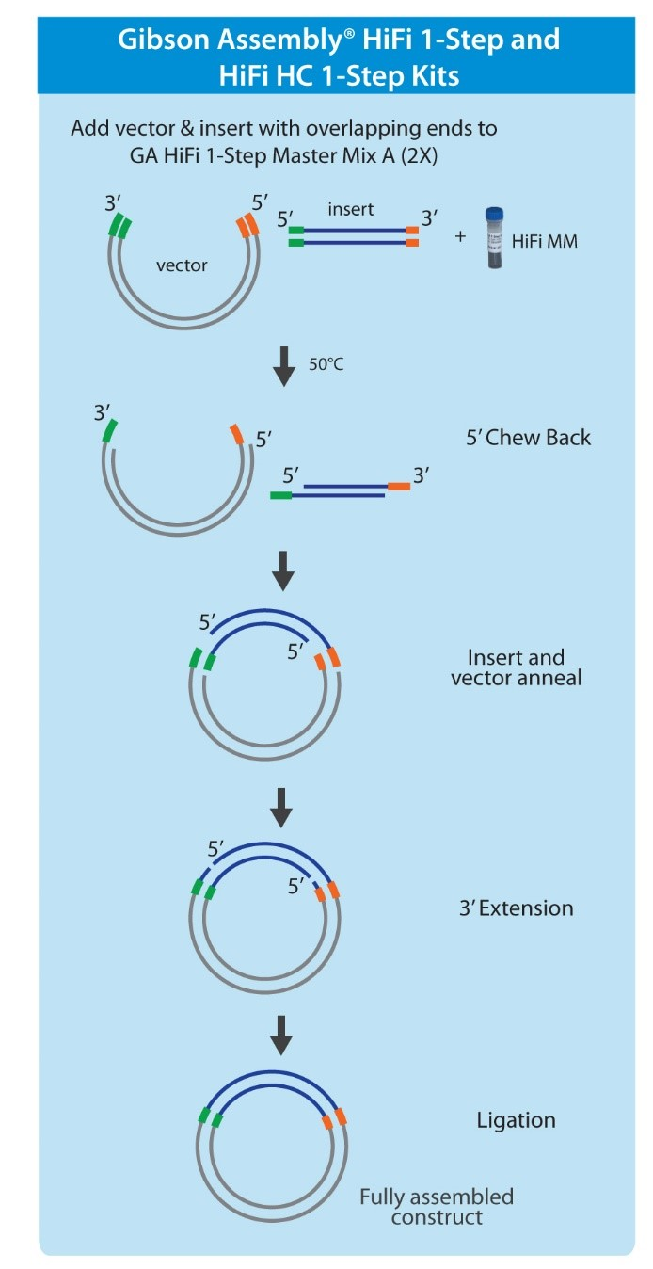
Cloning with Gibson Assembly (and closely related methods with different names)
Junctions can be anywhere; no need for restriction sites
Can assemble >2 pieces simultaneously
“Scarless” assembly
Know the three enzymatic activities involved
Need sequence overlap between insert and vector (or between multiple inserts)
Can prepare linear vector by restriction digest of PCR.

Slide 31
Another view showing the three enzymatic activities involved.
New England Biolabs HiFI cloning manual

Slide 36
The spectrum of cellular gene and genome structures
 | Prokaryotes | Eukaryotes
Chromosome shape | Usually circular | Linear
Plasmids | More frequent | Less frequent
Ploidy | Haploid | Variable
Protein coding content | ~80% | Variable (usually much less)
Introns | Rare | Common

Slide 37
DNA compaction and organization are the product of DNA compaction proteins and supercoiling
Notes:
Supercoiling
DNA binding proteins

Slide 38
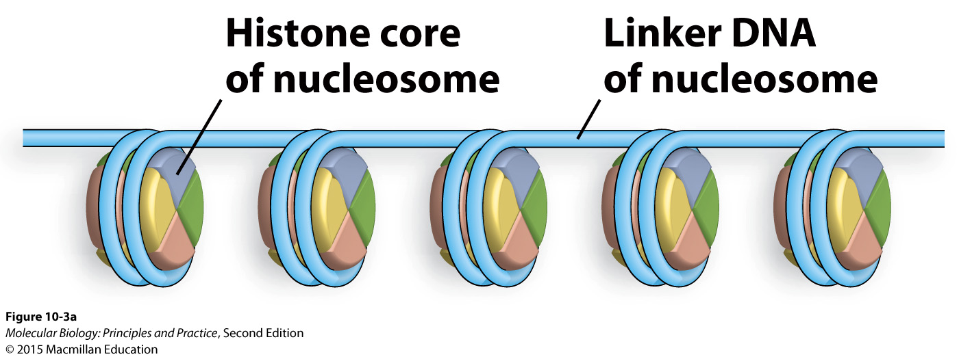
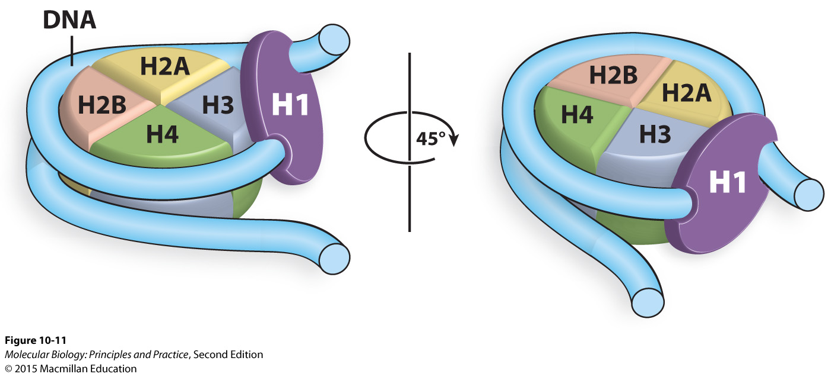
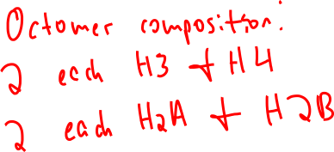
Histones constitute the first level of DNA compaction proteins
H1 is optional and leads to more tightly packed (transcriptionally inactive) chromatin

Slide 39
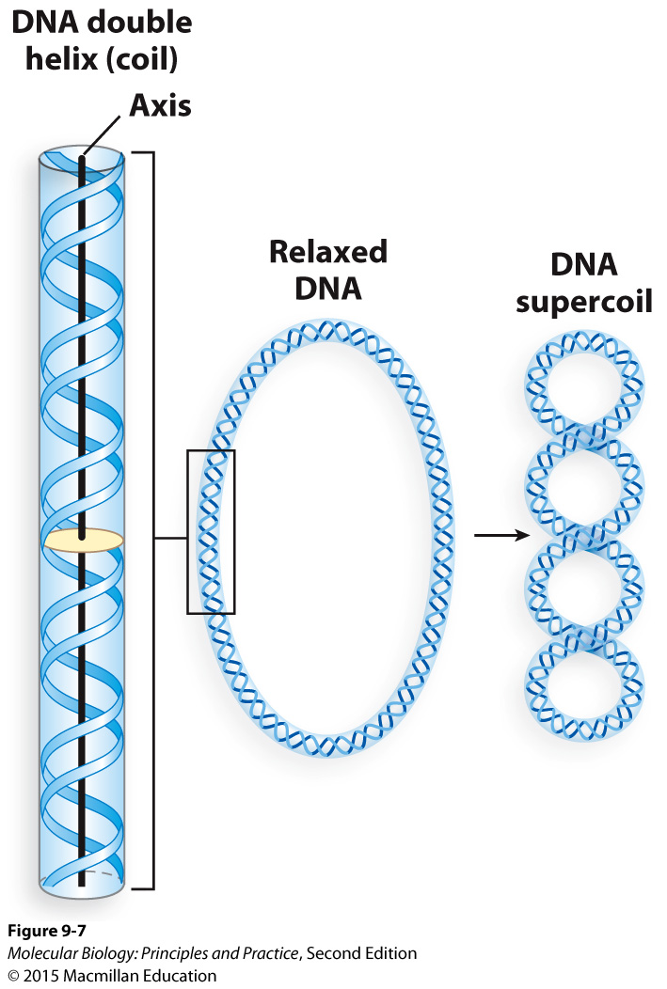
Supercoiling
Over-winding of the double helix is positive supercoiling, under-winding of the double helix is negative supercoiling.
Supercoiling can be considered as a local property or at the level of an entire chromosome or chromosomal domain.
If the ends of the DNA are fixed in place, local positive supercoiling must be balanced out by local negative supercoiling somewhere else in the molecule.
Only topoisomerase activity leads to net changes in supercoiling (change in linking number or ΔLk)
Some topoisomerases directly introduce supercoils, others relax supercoils.

Slide 40
Supercoiling cont’d
Transcription leads to local changes in supercoiling (positive in front of RNA pol, negative behind RNA pol) but no ΔLk.
Interaction with DNA binding proteins leads to local changes in supercoiling but in of itself does not lead to ΔLk.
Replication causes positive supercoiling ahead of the replication fork, and linking number is no longer a meaningful parameter for the molecule as a whole because it is no longer a single double helix.
Most organisms maintain their genomes in a net negatively supercoiled state.
Prokaryotes use topoisomerases that directly introduce negative supercoiling.

Slide 41
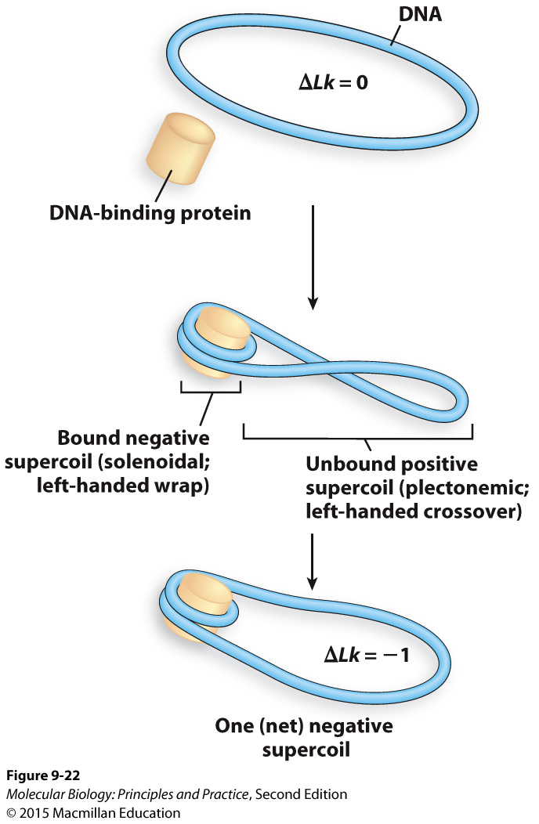
Eukaryotes produce a net negatively supercoiled state by two sequential activities
Wrap DNA around histones to create two opposite types of local supercoiling
Use a topoisomerase to relax the positive local supercoils in the unbound part of the DNA, leading to a NET negatively supercoiled state for the molecule as a whole.

Slide 42
Making and breaking phosphodiester bonds
In general: phosphodiester bonds are made and broken by nucleophilic attacks on phosphates.

Slide 43
DNA replication
Plasmids and circular prokaryotic chromosomes are replicated from a single origin of replication.
Linear eukaryotic chromosomes are replicated from multiple origins of replication.
When an origin fires, it produces two replication forks and move in opposite directions.

Slide 44
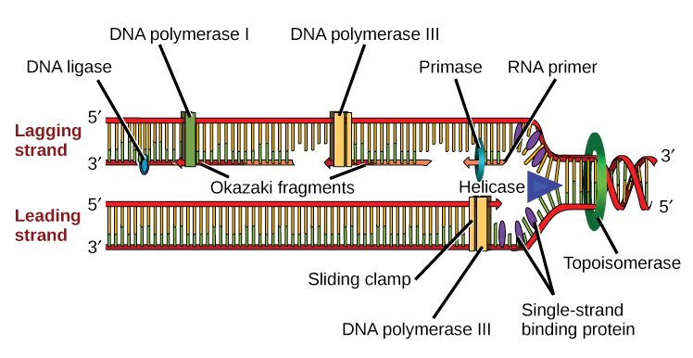
The bacterial DNA replication fork
Beta
Not shown here: Clamp loader
Know the function of each protein, be prepared to identify them on an unlabeled figure, be prepared to draw a replication fork and supply the proteins needed.
Image: Khan Academy

Slide 45
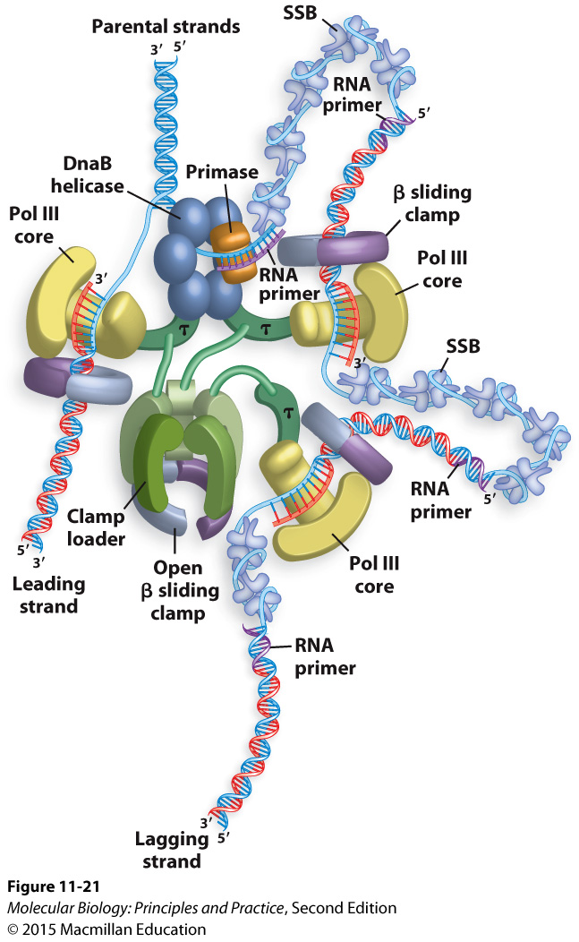
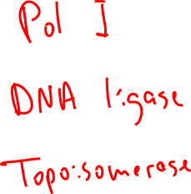
Another view of the bacterial DNA replication fork
(You do not need to be able to draw one that looks like this :)
What other proteins are required to complete replication?
Notes:
(topoisomerase, Pol I, ligase)

Slide 46
Gene replacement with an antibiotic resistance marker: a common and reasonably efficient method for making gene knockouts in bacteria and yeast.
PCR product
hyg^{R}
M. smegmatis chromosome
…
rnase J
…
M. smegmatis chromosome
…
hyg^{R}
…

Slide 47
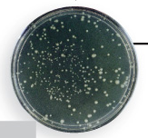
PCR
Transformation
Homologous recombination is naturally very efficient in budding yeast (Saccharomyces cerevisiae)
The gene replacement cassette is a linear piece of DNA usually made by PCR.
In many bacteria, a separate helper plasmid is needed to express exogenous recombinases and increase recombination efficiency.
Drug selection
Test the phenotype of the strain!

Slide 48
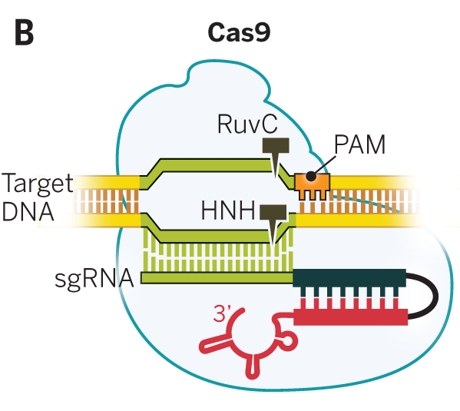
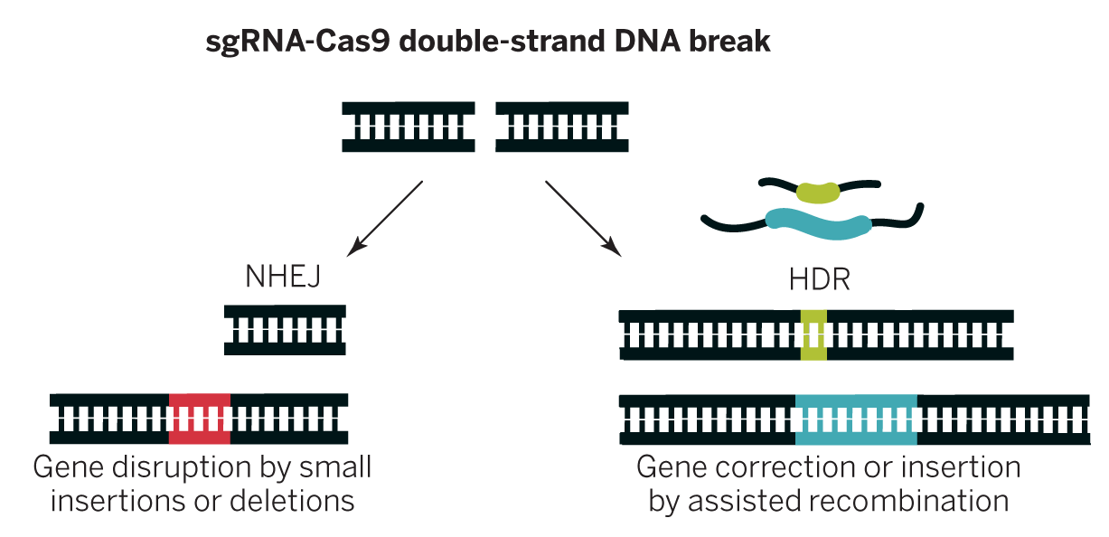
sgRNA-Cas9 together cause a double-strand break at a location specified by the sgRNA sequence and presence of a PAM
Note that the sgRNA is a single strand including the green, black, and red segments
Target DNA
Doudna and Charpentier. Science 2014;346:1258096
Notes:
Cas9 recognizes PAM, will not cleave targeted site in absence of that recognition.

Slide 49
Cas9-induced double-strand breaks can be repaired in two ways useful for genetic engineering
Doudna and Charpentier. Science 2014;346:1258096
Notes:
Why would you want to use the NHEJ method? The HDR method?

Slide 50
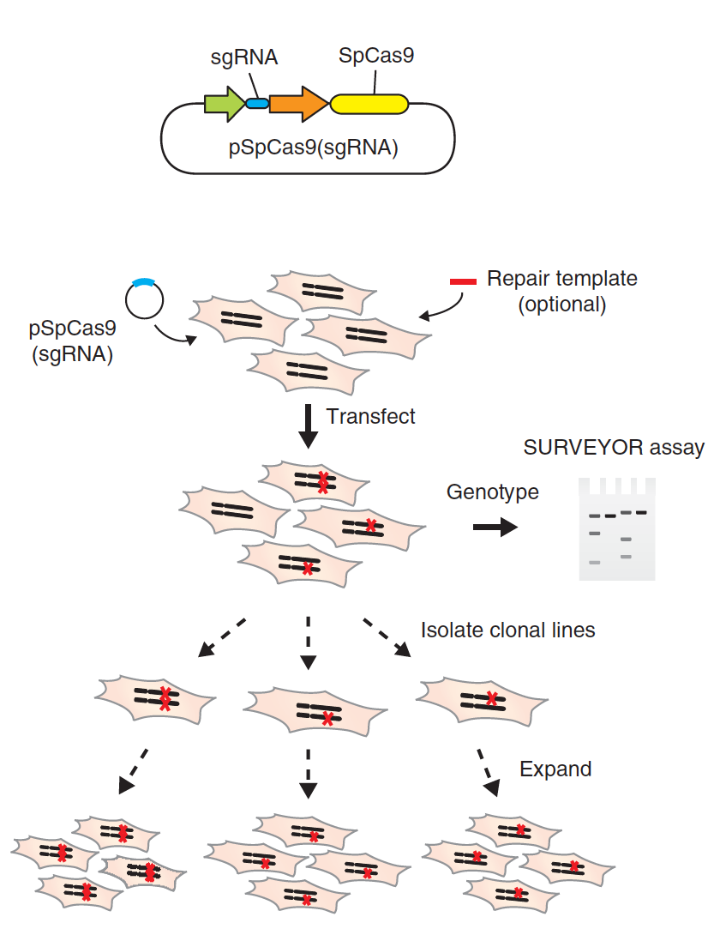
A basic CRISPR-Cas9 genome editing workflow
Design, make, and purify plasmid to express Cas9 and sgRNA
Repair template (optional – when would you use one?)
and genotype
Ran et al (2013). Nature Protocols, 8(11), 2281–2308. http://doi.org/10.1038/nprot.2013.143

Slide 51
Techniques for sequencing DNA
Why might you want to perform DNA sequencing? Think of hypothetical scenarios.
Why would you choose Sanger sequencing vs a next-generation sequencing technique such as Illumina?

Slide 52
Sanger sequencing
Appropriate and cost-effective for sequencing small numbers of DNAs at a time (eg, a single gene, a few genes, or a cloning product).
Like a one-sided PCR that uses a single primer and a mix of dNTPs and fluorescently labeled ddNTPs.
End up with a mix of ssDNA molecules of various lengths each with a labeled ddNTP at the 3’ end.
Use capillary gel electrophoresis to determine the base at the 3’ end of each uniquely sized product molecule.

Slide 53
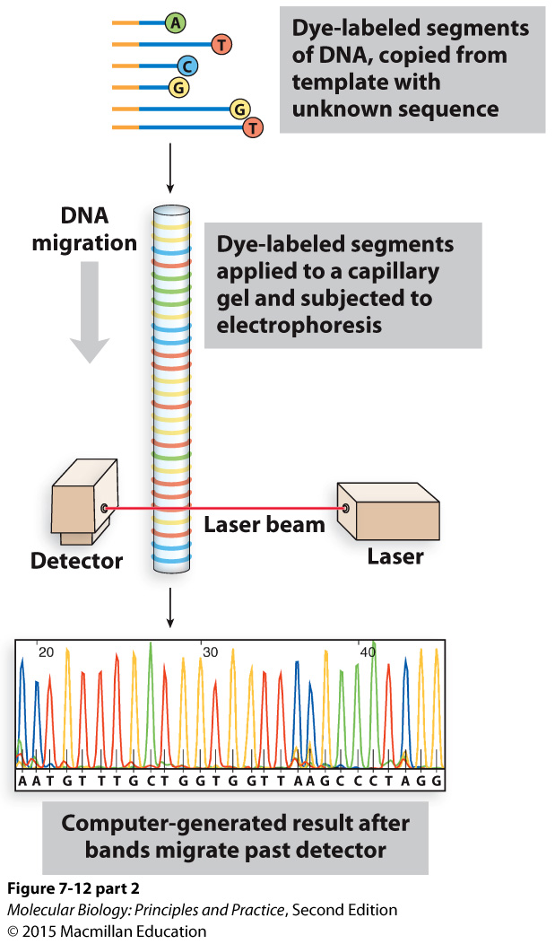
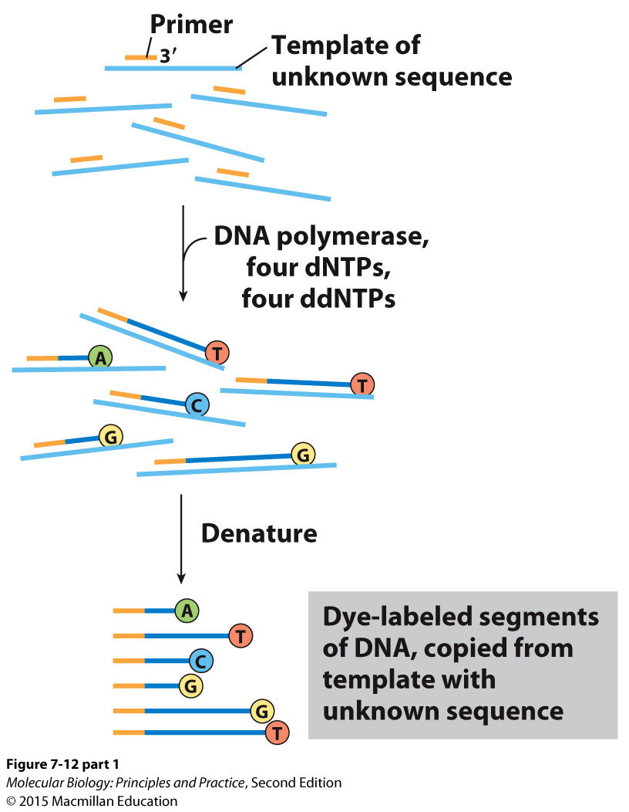
Sanger sequencing

Slide 54
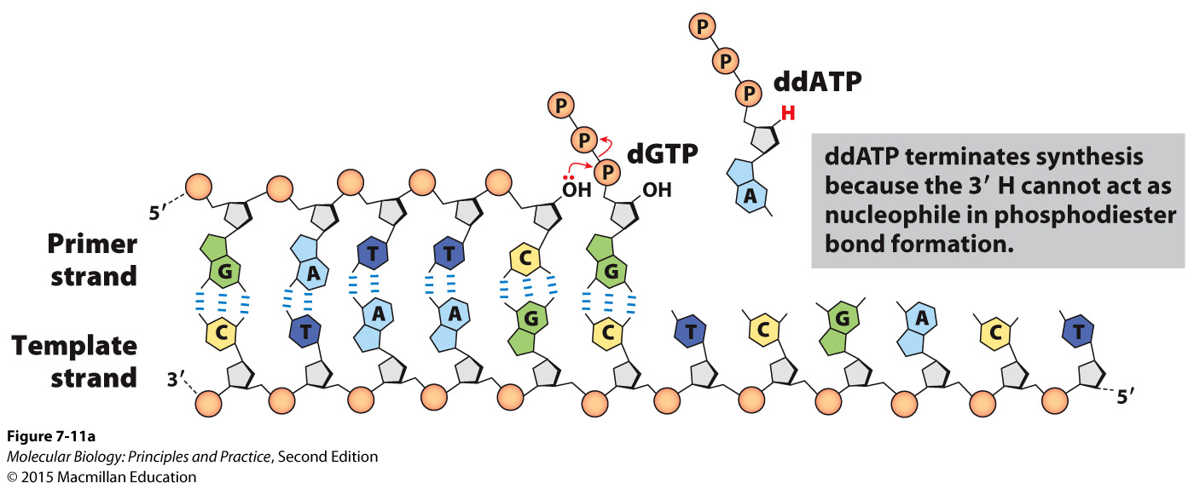
Sanger sequencing

Slide 55
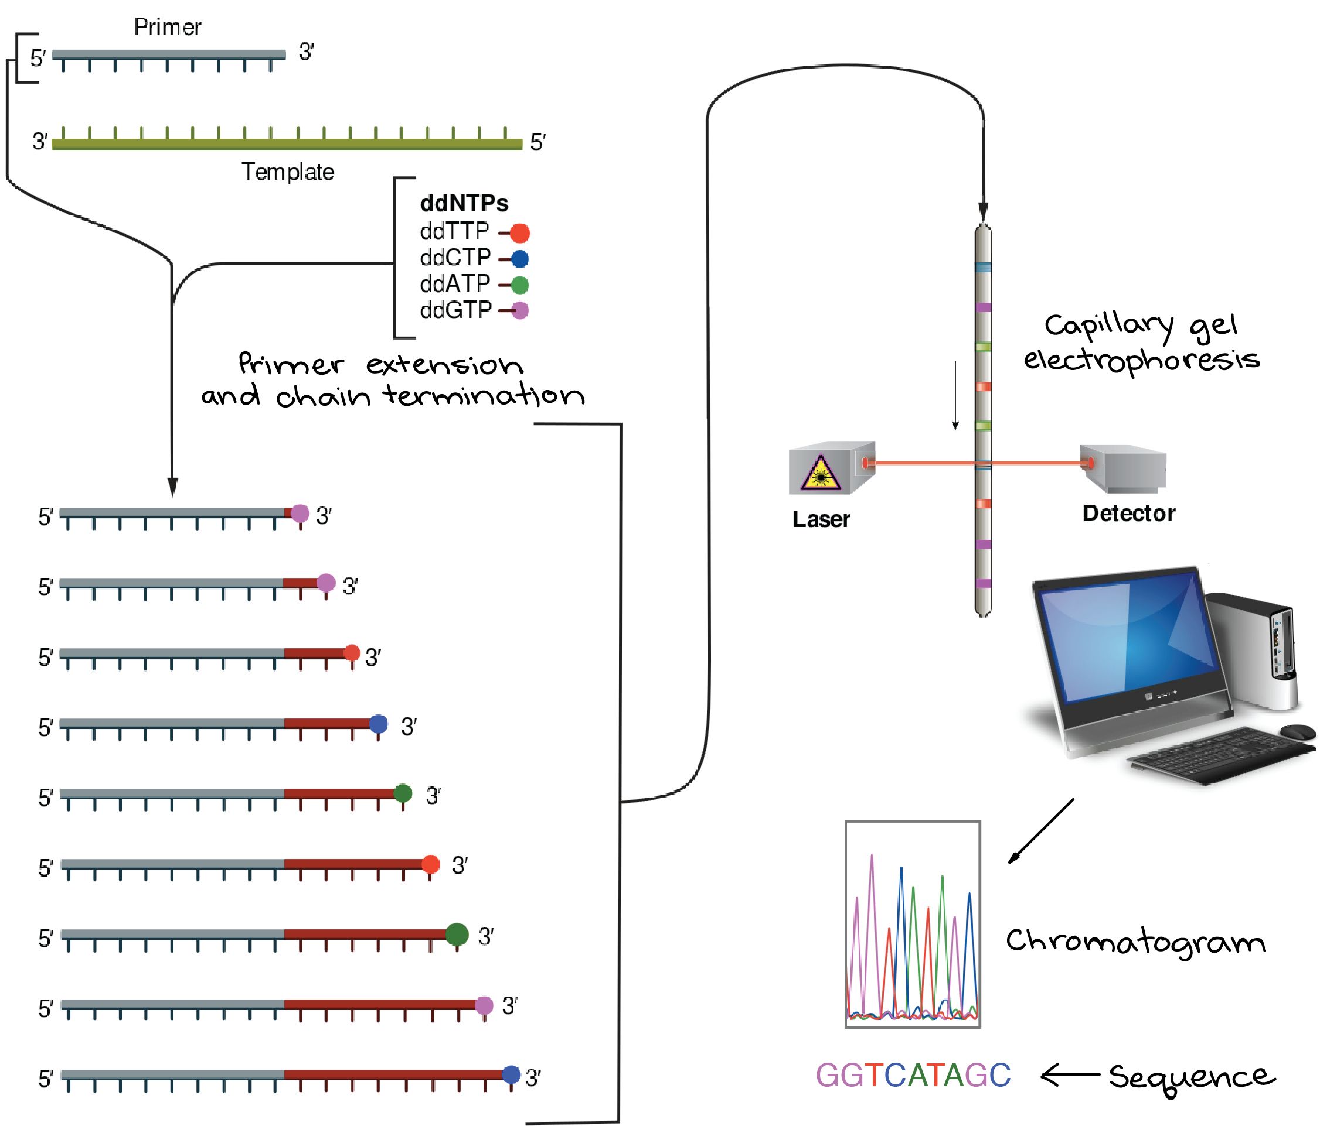
Sanger sequencing
Graphic: https://www.khanacademy.org/science/biology/biotech-dna-technology/dna-sequencing-pcr-electrophoresis/a/dna-sequencing

Slide 56
Illumina sequencing
A type of next-generation sequencing, appropriate and cost-effective for sequencing thousands or millions of DNAs at a time (eg, whole genomes).
Molecules of interest must be made into a library in which they are flanked by common adapter sequences.
Library molecules anneal to primers stuck to the surface of a flow cell, and in situ PCR is used to turn each molecule into a cluster of identical molecules.
Sequencing is carried out by multiple cycles in which fluorescently labeled dNTPs with blocked 3’ ends are added, incorporated by DNA polymerase, imaged, and chemically treated to remove the label and 3’ block.
Each cluster produces a read (a series of nts in order). The reads can be aligned to a reference genome to identify positions where the sample and the reference differ, or the reads can be aligned to each other to determine the sequence de novo.

Slide 57
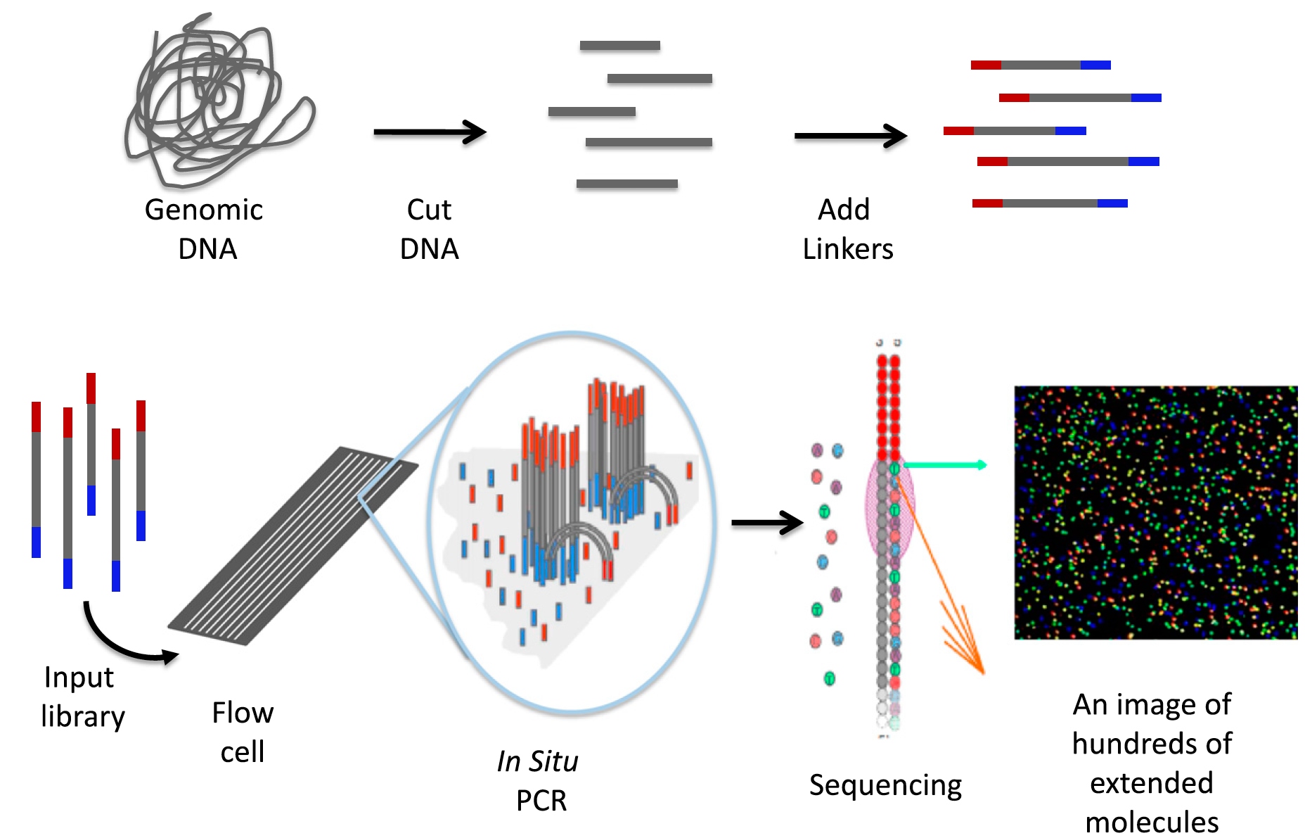
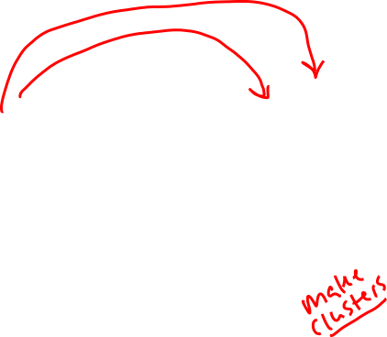
Illumina sequencing
Shear DNA
Add adapters
Library
Each cluster (dot) reports the sequence of a different molecule
Johnsen J M et al. Blood 2013;122:3268-3275

Slide 58
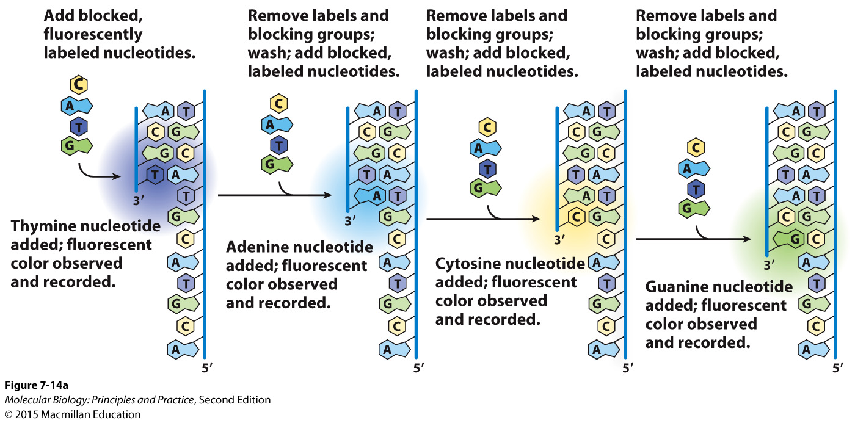
Illumina sequencing

Slide 59
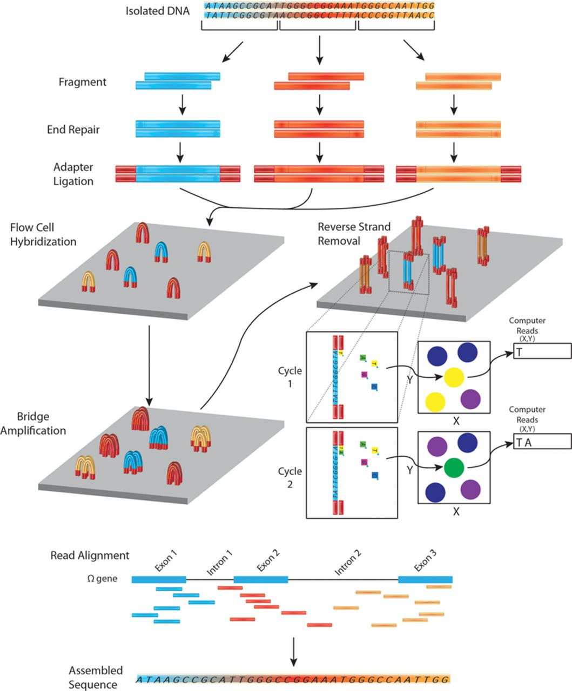

Overview of DNA sequencing using the Illumina platform.
Jared M. Churko et al. Circ Res. 2013;112:1613-1623
Copyright © American Heart Association, Inc. All rights reserved.
Notes:
Overview of DNA sequencing using the Illumina platform. In next-generation DNA sequencing, DNA is first fragmented into smaller input-sized fragments by enzymes or by sonication. The ends of these fragments are repaired and specific adapters are ligated to the ends of the fragments, allowing hybridization to a flow cell to occur. A bridge amplification step is performed to create a cluster of fragments with the same sequence. One strand of DNA is removed and fluorescently labeled nucleotides are passed by each cluster. An image of the flow cell is recorded for the first cycle and a computer processes which nucleotide was incorporated at each cluster’s co-ordinates. The fluorescent label is cleaved and a second round of fluorescently labeled nucleotides is passed by each cluster. Again (cycle 2) the nucleotide is recorded and each cycle leads to the sequence of each fragment (a read). These reads are then aligned to a reference genome. By assembling reads (merging short reads together), it is therefore, possible to reconstruct the unfragmented original sequence.

Slide 60
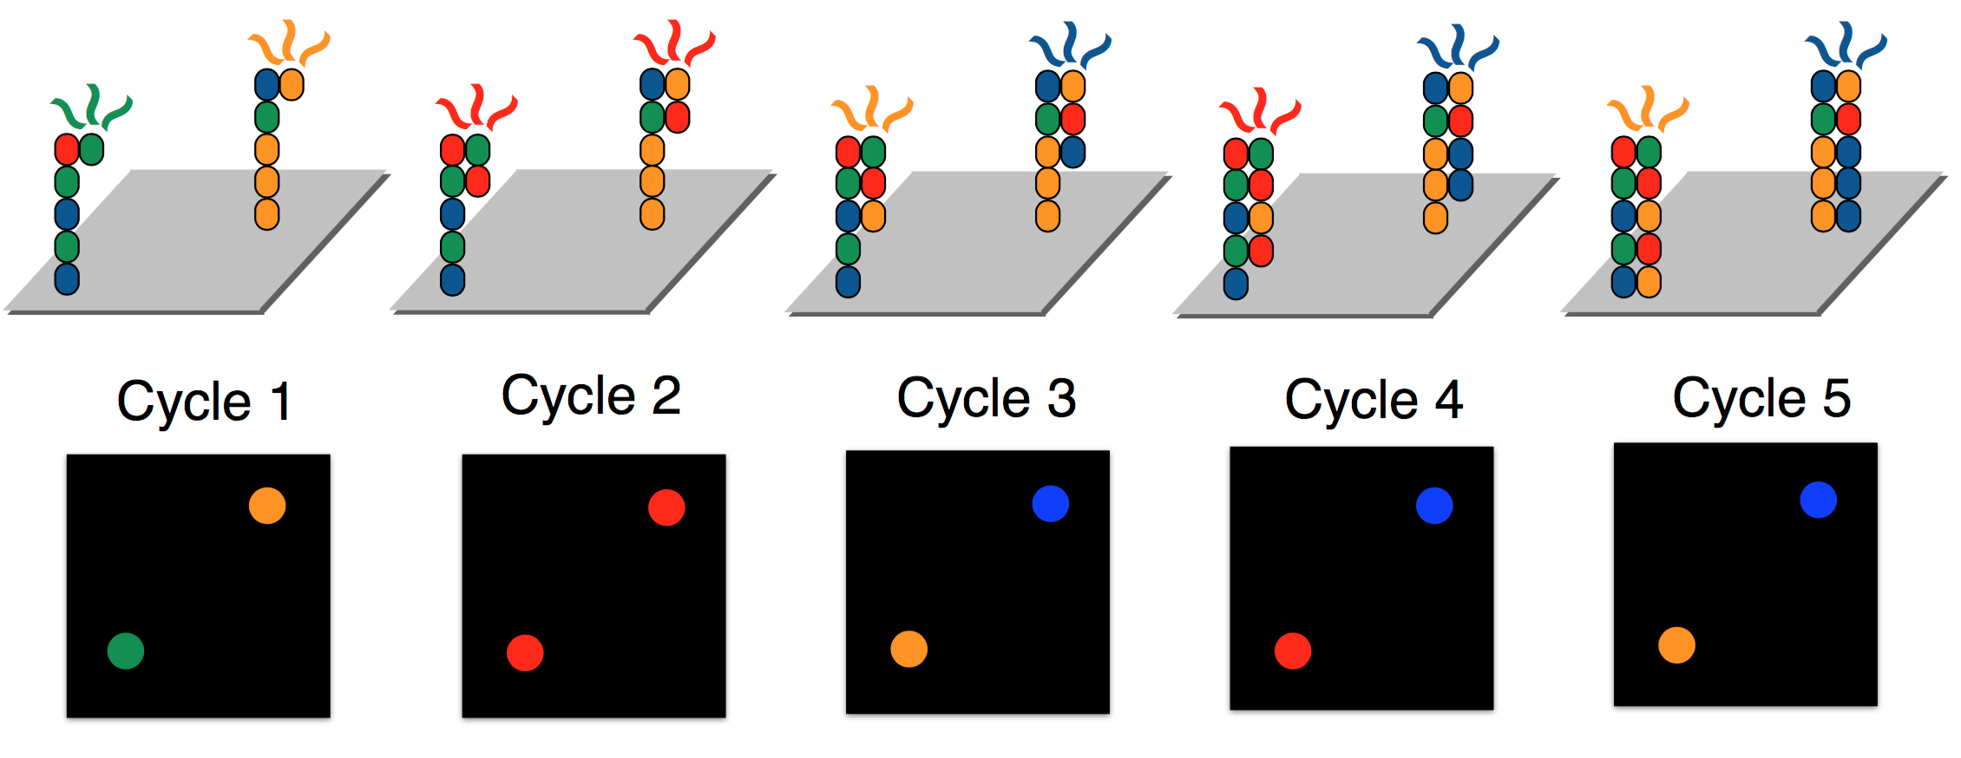
A cluster on an Illumina flow cell emits a different colored light depending on the identity of the most recently incorported nt
The sequence of consecutive nts recorded for an individual cluster are a read
Graphic: http://data-science-sequencing.github.io/lectures/lecture2/

Slide 61
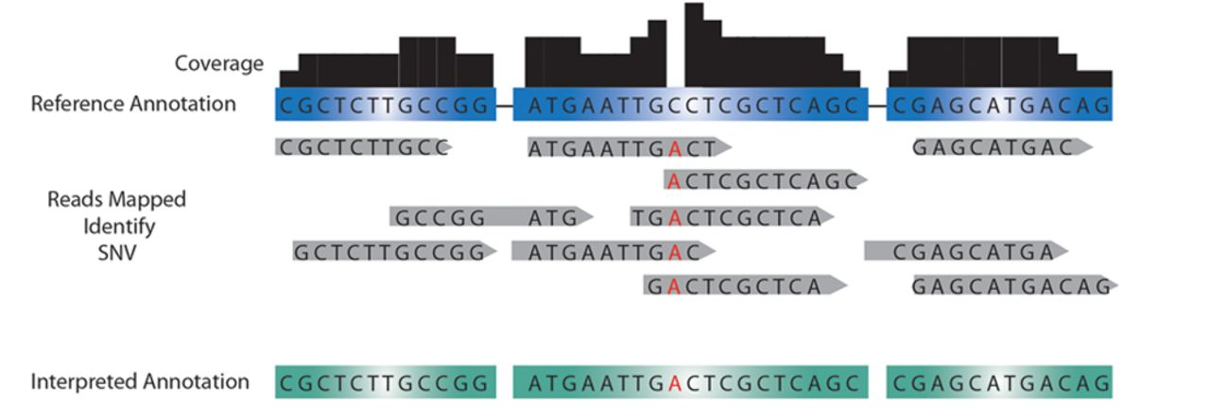
Detection of single-nucleotide variants
Jared M. Churko et al. Circ Res. 2013;112:1613-1623
Copyright © American Heart Association, Inc. All rights reserved.
Notes:
Detection of single-nucleotide variants (SNVs) and copy number variants (CNVs). Mapping HTS reads to control annotations (unaffected family member, reference annotation) is used to identify single-nucleotide changes up to large structural DNA changes. Discrepancies between the reference annotation and the mapped sequence can be called to annotate SNV. More reads mapped (ie, higher read depth) results in a higher confidence level to the called SNV in question. If a disproportionate amount of reads are mapped to a gene for a given read depth, this region of DNA may be interpreted as a CNV.

Slide 62
Sequencing a new/unknown genome
Instead of aligning reads to a reference sequence, reads are aligned to each other. With enough overlapping reads, the sequence of most of the genome can be pieces together.

Slide 63
Techniques for measuring gene expression
Why might you want to measure gene expression? Think of a hypothetical experiment.
Why would you choose quantitative PCR, microarrays, or RNAseq?

Slide 64
Quantitative PCR
To use for measuring gene expression, RNA is converted to cDNA by reverse transcription, then cDNA is used as template in PCR.
Quantitative PCR uses fluorescent dyes or probes and a special instrument to measure the amount of product present after each cycle.
In early cycles, the amount of product doubles after each cycle and is thus proportional to the amount of starting material.
The cycle at which the amount of product crosses a threshold is called the ct. By comparing the ct obtained from different genes or samples, the relative abundance of each gene can be determined.
Appropriate and cost-effective for measuring the expression of a small number of genes.
Large dynamic range.

Slide 65
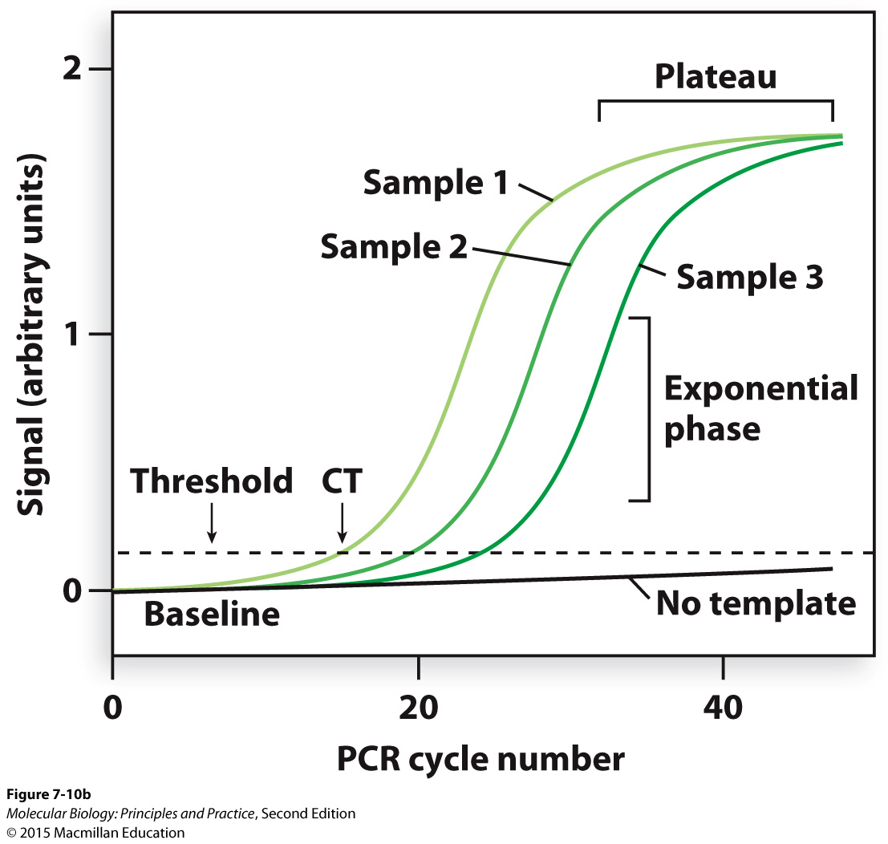
Amplification is exponential only in the early cycles of PCR

Slide 66
Microarrays
RNA is converted to cDNA by reverse transcription using fluorescently labeled dNTPs, then cDNA is allowed to hybridize to complementary oligonucleotides spotted on the surface of a glass slide.
If two samples are labeled with different colors then mixed and applied to the same array, the relative abundance of each RNA in each sample can be determined by comparing the amount of each color at each spot.
Appropriate and cost-effective for measuring the expression of thousands of genes at a time.
Limited dynamic range.

Slide 67
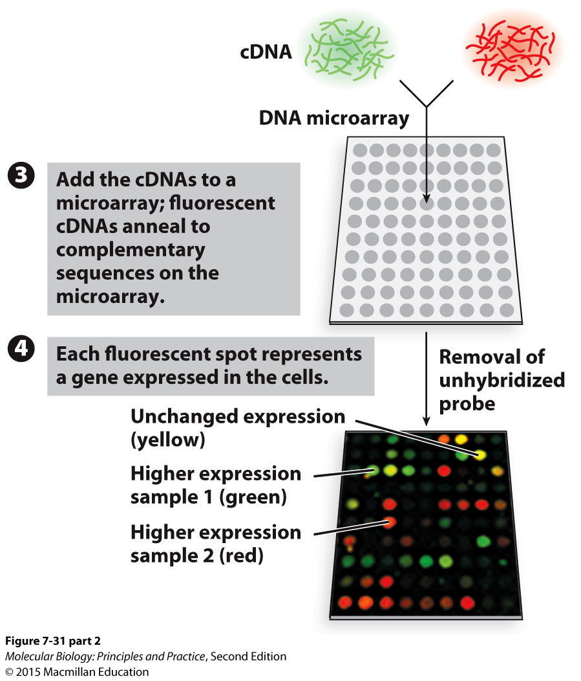
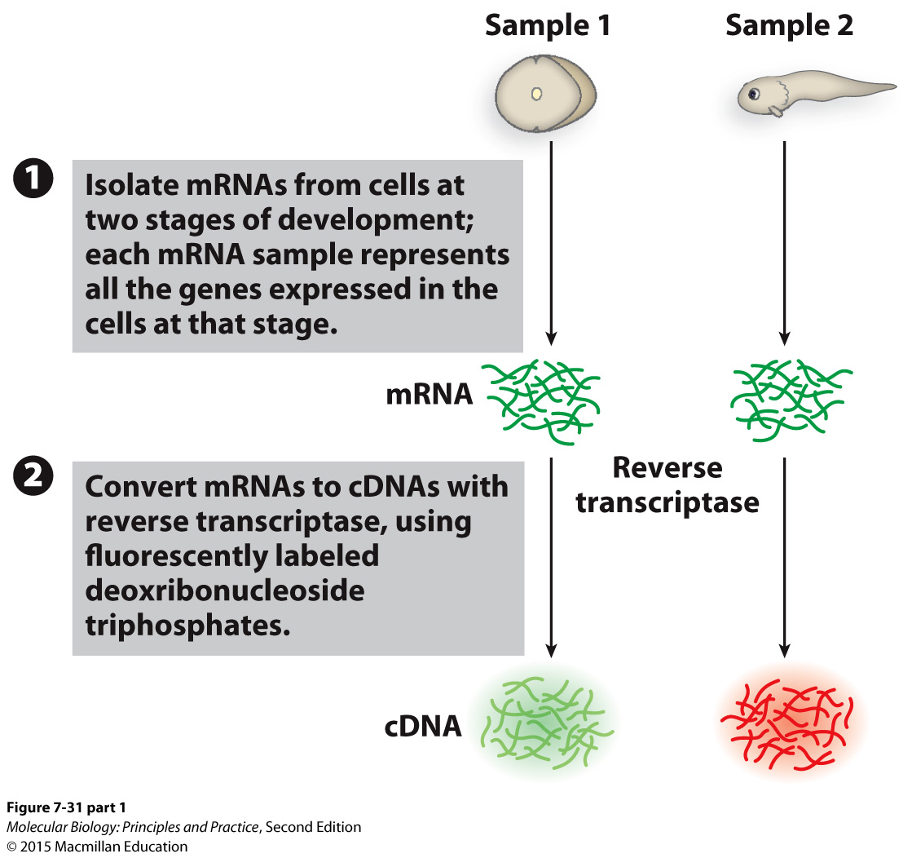
Microarrays

Slide 68
RNA-seq
Like regular Illumina sequencing, but:
Starting material is RNA converted to cDNA before constructing the library.
Analyze data differently: align reads to a reference genome, then count the number of reads aligning to each gene or region of interest.
Allows analysis of expression without any assumptions of which regions of the genome will be expressed.
Appropriate and cost-effective for measuring the expression of thousands of genes at a time.
Large dynamic range.

Slide 69
RNA-seq
Shear and reverse transcribe
RNA
cDNA
Library
Johnsen J M et al. Blood 2013;122:3268-3275

Slide 70
RNA-seq
Number of reads at each position
Quantification: count and compare reads aligning to each gene or region of interest.

Slide 71
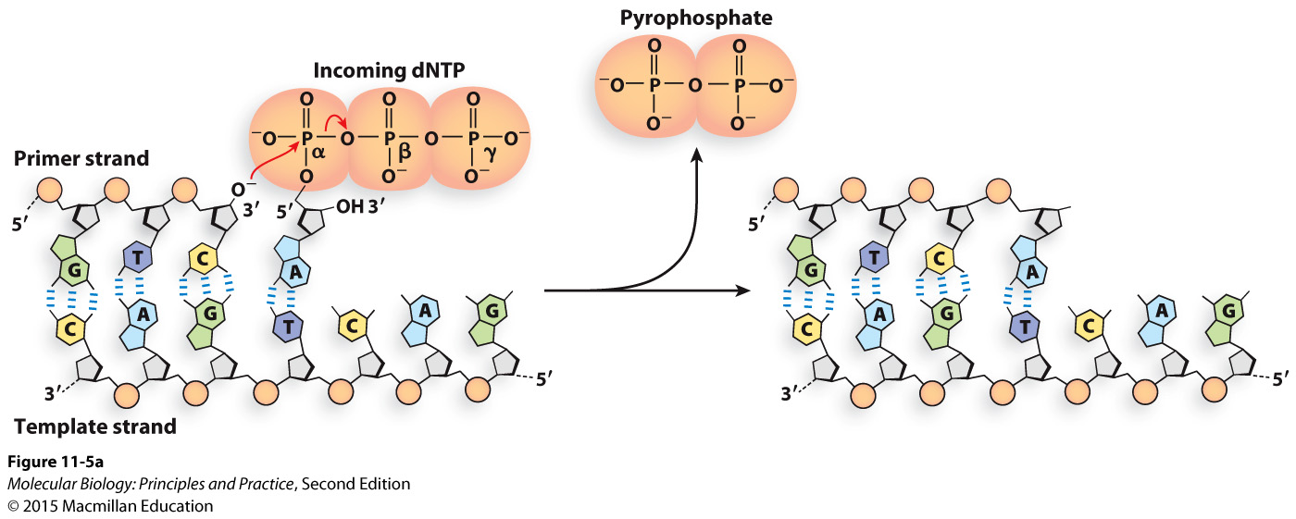
The chemistry of DNA polymerization
Nucleophilic attack on P in phosphate by deprotonated O in hydroxyl.
Replacing one high-energy bond with another is energetically close to neutral.
Formation of hydrogen bonds and base stacking interactions make DNA polymerization energetically favorable.
Much of the energy needed for DNA polymerization therefore goes into synthesis of the dNTPs.
Notes:
What kind of reaction is this? Which atom is the nucleophile?

Slide 72
Many DNA polymerases have exonuclease activity
Pol III: 3’ to 5’ exonuclease activity is used for proofreading
Pol I: 5’ to 3’ exonuclease activity is used for degrading primers, 3’ to 5’ exonuclease activity is used for proofreading
Exonuclease activities are contained in separate domains or active sites (it’s not a reversal of the polymerization reaction)

Slide 73
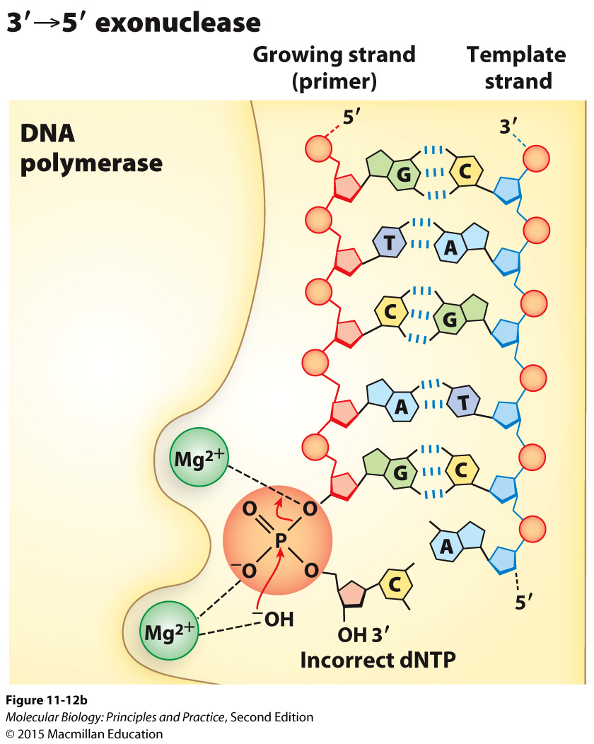
The chemistry of 3’ to 5’ exonuclease activity
(recall: phosphodiester bonds are made and broken by nucleophilic attacks on phosphorus atoms in phosphates)

Slide 74
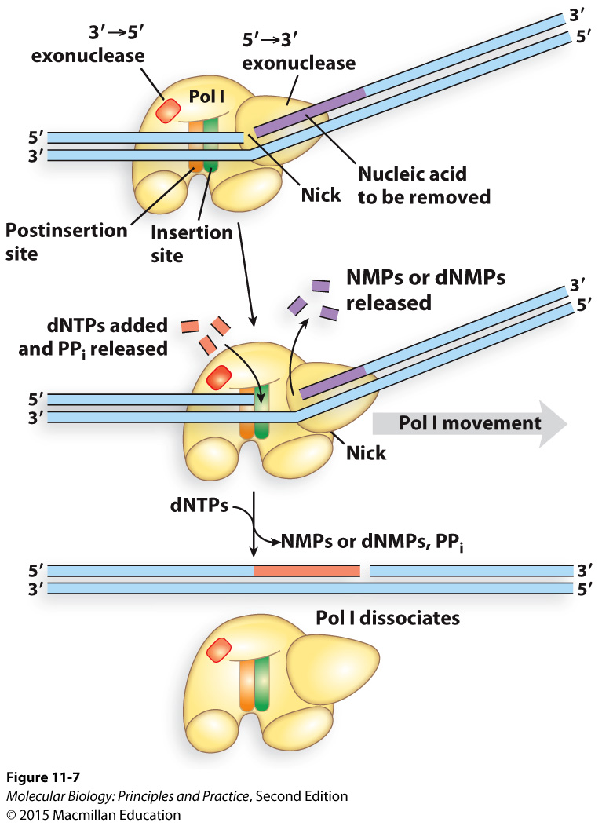
Pol I uses 5’ to 3’ exonuclease activity to remove RNA primers and then replaces them with DNA

Slide 75
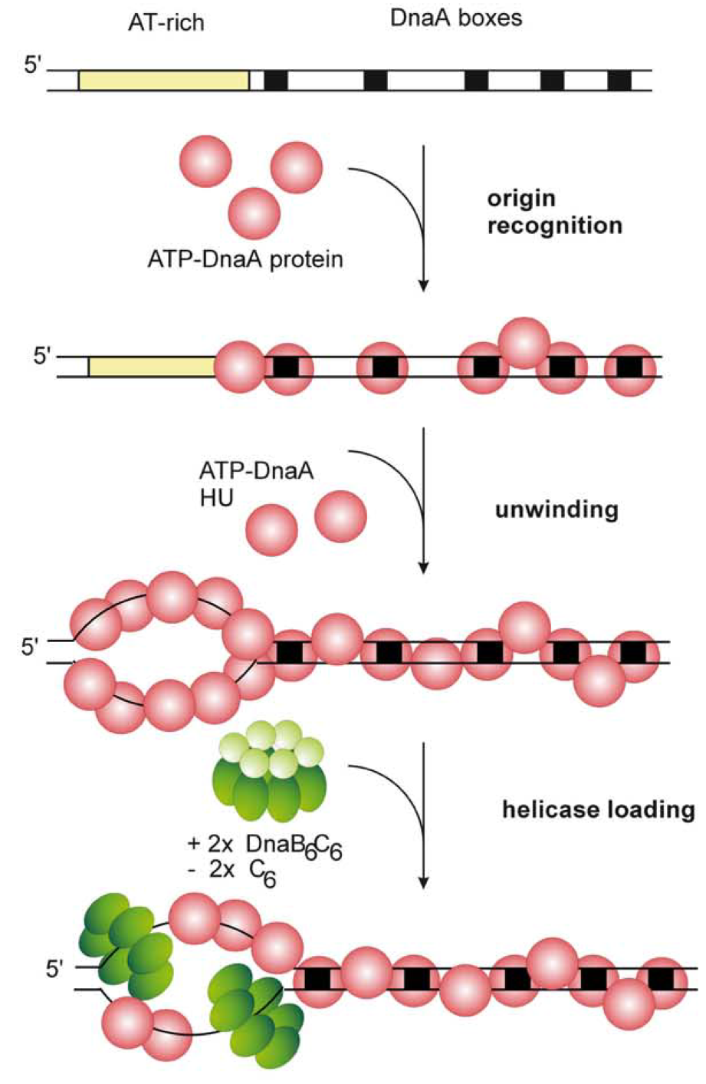
Initiation of DNA replication
DnaA is the initiator in bacteria.
In eukaryotes, the origin recognition complex (ORC) performs an analogous function.
The expression, binding, and activity of DnaA and ORC are highly regulated.
Messer, W. (2002) FEMS Microbiology Reviews, 26(4), 355–374.

Slide 76
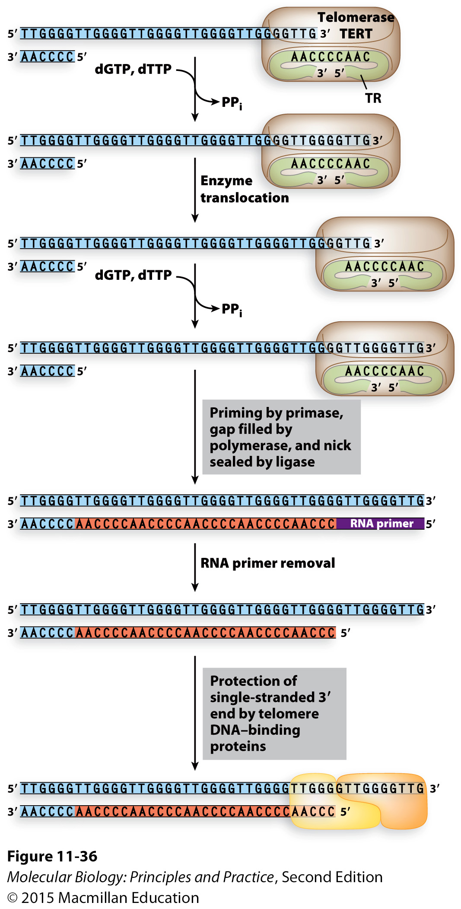
Telomerase uses an RNA template to extend the ends of chromosomes
What is a telomere?
Why do chromosome ends shorten during replication?
In which cells types is chromosome shortening a problem?
What is telomerase composed of?
How does telomerase prevent telomere shortening?
Why do most cancer cells express telomerase?

Slide 77
Types and sources of DNA damage Be prepared to explain where it comes from and the consequences if unrepaired (effects on replication, mutations that might ensue)
Base misincorporations
Polymerase slippage
Thymine dimers
Spontaneous hydrolysis examples:
Cytosine deamination
Loss of base/formation of abasic site
Other types of damage: if given an example and told its propensity for mis-pairing, be able to state the mutation that will result
Strand breaks

Slide 78
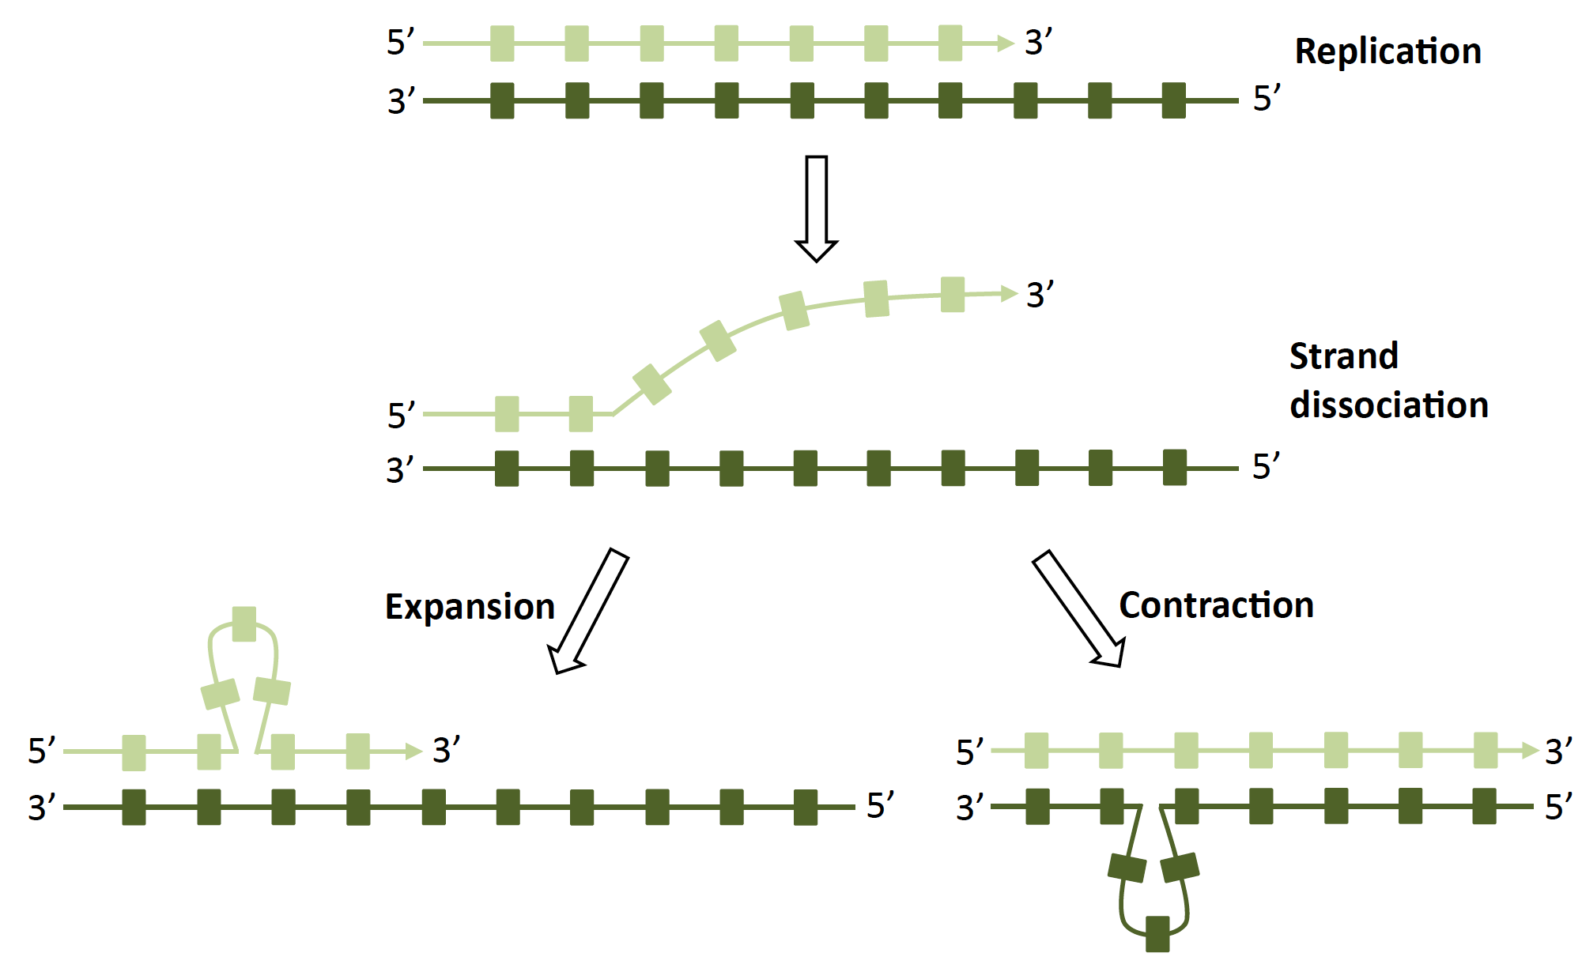
Polymerase slippage -> indels
Occurs most frequently at mononucleotide repeats and trinucleotide repeats
Top strand has insertion
Top strand has deletion

Slide 79
Damage that leads to base misincorporations by normal replicative polymerases
Cytosine deamination
Replication
AAGUGT
TTCACA
AAGTGT
TTCACA
AAGCGT
TTCGCA
AAGUGT
TTCGCA
Replication
C->T mutation
(G->A mutation)
AAGCGT
TTCGCA
Replication
AAGCGT
TTCGCA
Guanine oxidation
AAGCGT
TTCGCA
AAGCGT
TTCGCA
Replication
AAGAGT
TTCTCA
AAGAGT
TTCGCA
8-oxo
C->A mutation
(G->T mutation)
8-oxo

Slide 80
Damage that leads to replication fork stalling, followed by translesion synthesis (TLS) polymerase bypass or cell death
Loss of base
(abasic site)
Replication
AAG-GT
TTCNCA
(N=base incorporated by error-prone TLS polymerase)
AAGCGT
TTCGCA
AAG-GT
TTCGCA
AAGCGT
TTCGCA
Replication
AAGCGT
TTCGCA
UV
AAGCGT
TTCGCA
AAGCGT
TTCGCA
Replication
NNGAGT
NNCTCA
NNGAGT
TTCGCA
(N=base incorporated by error-prone TLS polymerase)

Slide 81
Pathways for repairing or tolerating DNA damage
Translesion synthesis polymerases (what they are, how they work, consequences for the cell)
High-fidelity repair of damaged, mispaired, or missing bases:
Base excision repair
Nucleotide excision repair
Mismatch repair
Repair of double strand breaks:
Homologous recombination (high fidelity, all organisms, requires replicated chromosome or access to homologous chromosome)
Non-homologous end joining (low-fidelity, primarily eukaryotes)

Slide 82
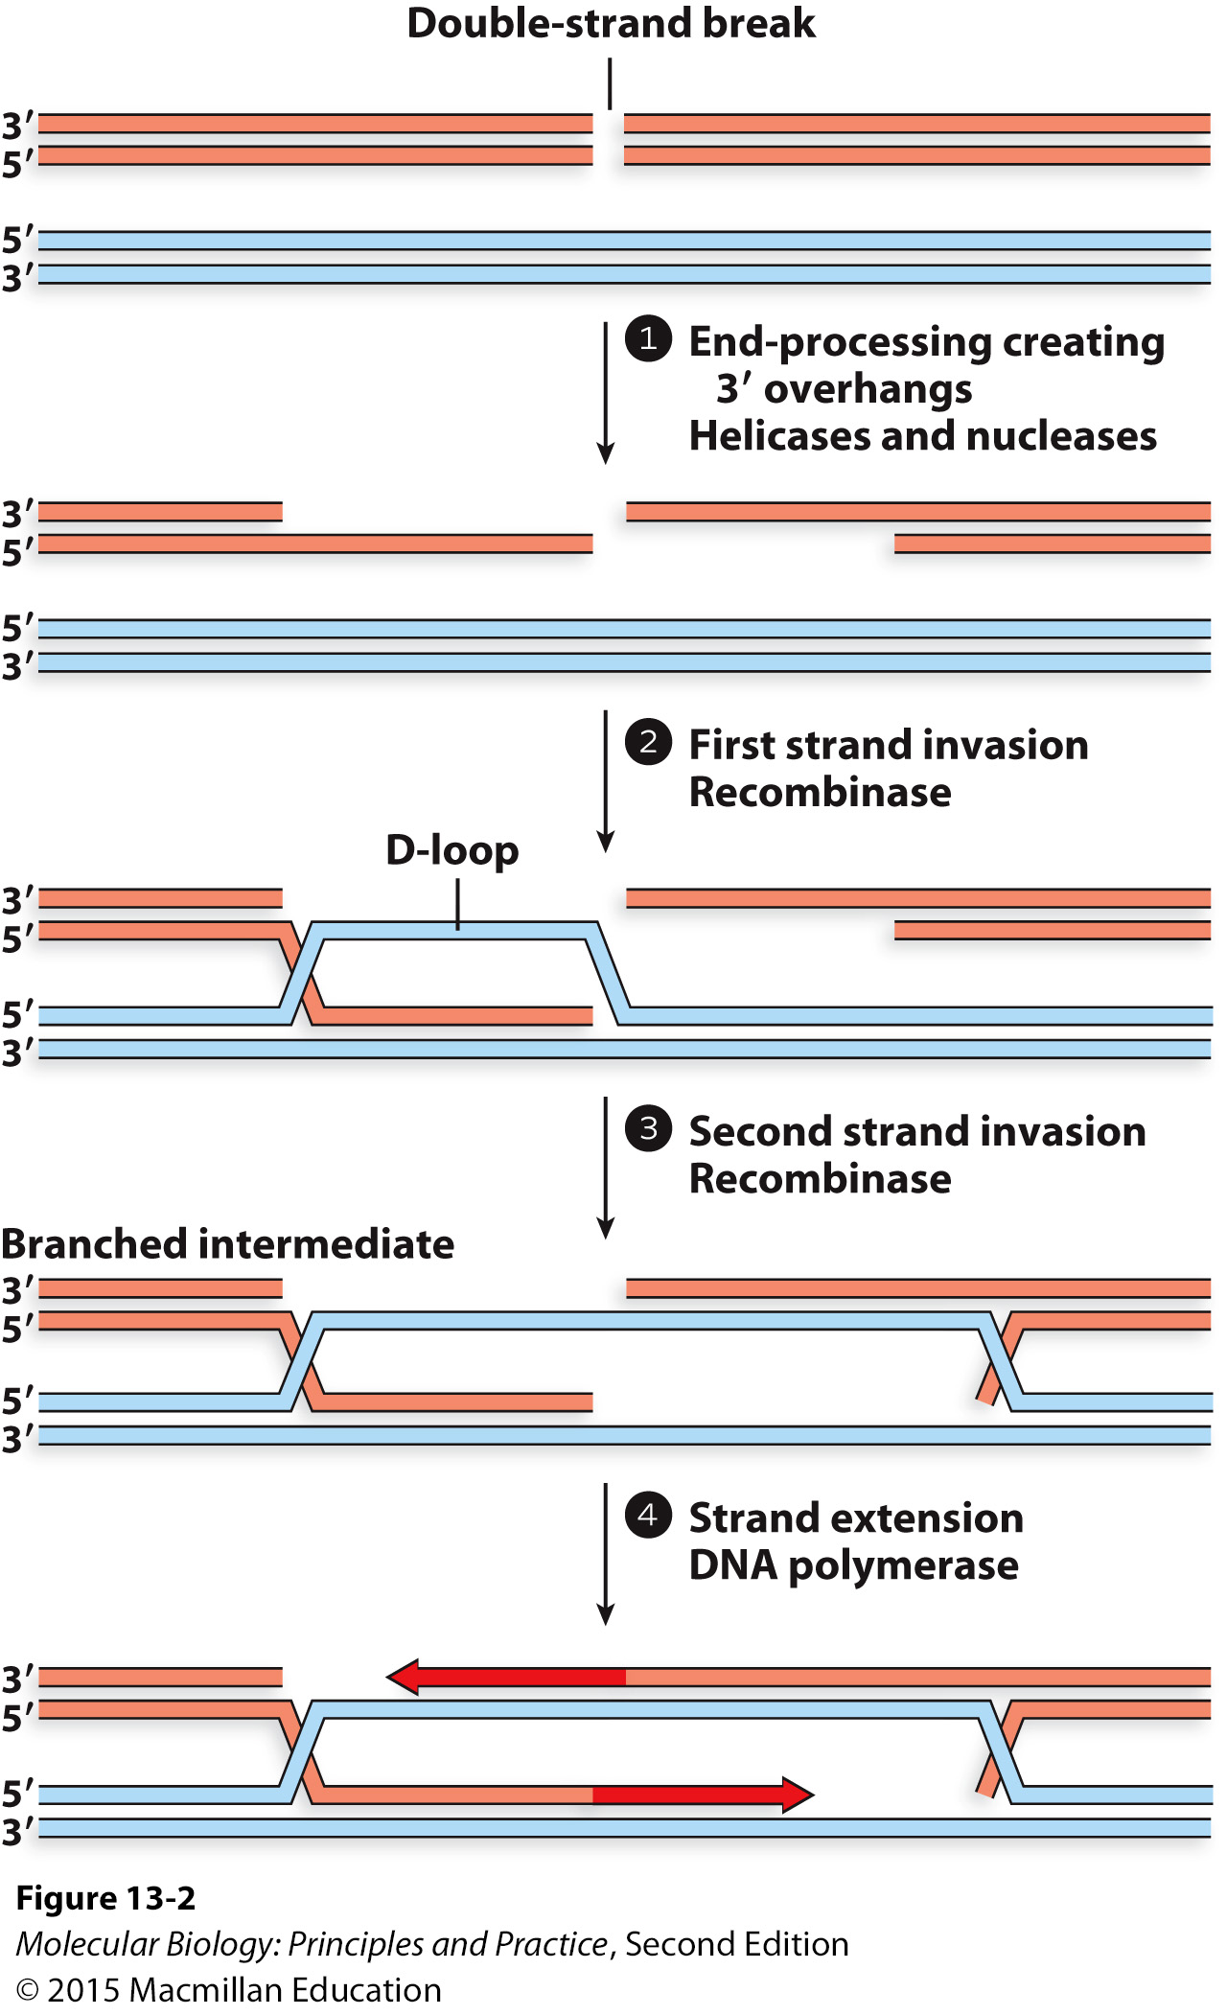
Homologous recombination
Be prepared to describe what is happening at each step if given an unlabeled figure, or what will happen next if given part of a figure.

Slide 83
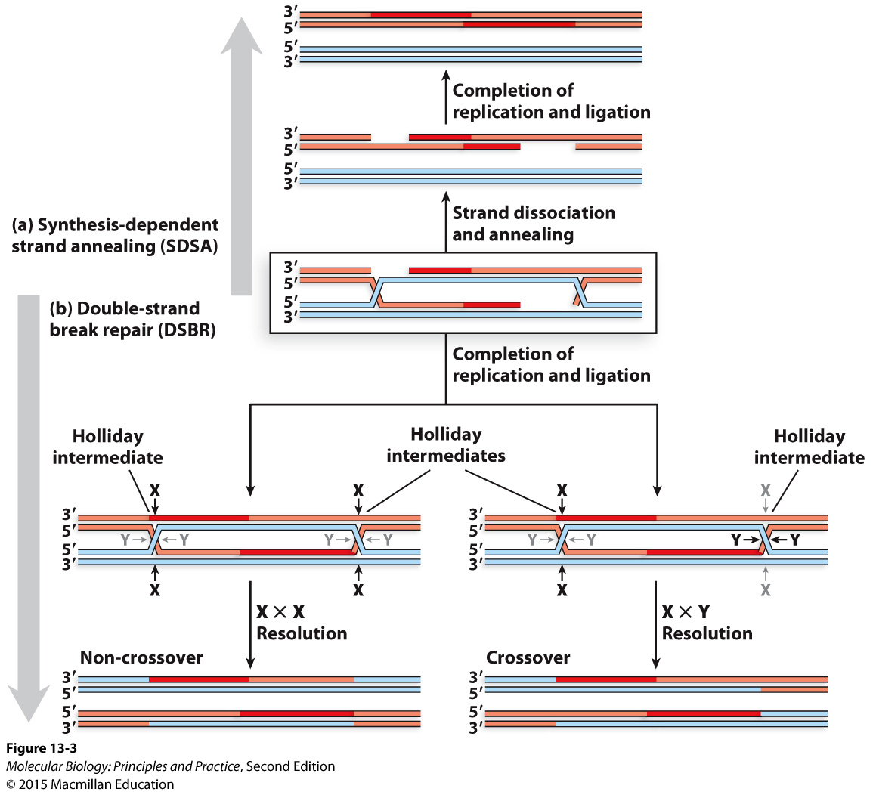
Homologous recombination
Be prepared to describe what is happening at each step if given an unlabeled figure, or what will happen next if given part of a figure.
Know the roles of recombinases RecA and RAD51, and Holliday junction resolvases.

Slide 84
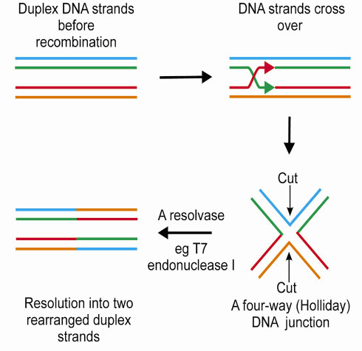
Resolution of a single Holliday junction
Graphic: http://www.esrf.eu/UsersAndScience/Publications/Highlights/2001/life-sciences/LS7.html

Slide 85

Transcription: the relationship between the coding strand, the template strand, and the RNA sequence

Slide 86

The chemistry of RNA polymerase activity

Slide 87
Some key aspects of transcription
Bacteria has one RNA Pol, eukaryotes have three – know names and functions
RNA polymerases have little or no proofreading activity.
Bacterial RNA pol requires a sigma factor to recognize, bind, and melt promoters and initiate transcription. Eukaryotic RNA Pol II requires general TFs (TBP and others).
Core promoters are bound by sigma/general TFs plus RNA pol.
Upstream promoter regions and enhancers are bound by other TFs that can enhance, repress, and conditionally regulate transcription.
Sigma and most general TFs are not needed for elongation and termination.
Promoter sequences, the proteins required to initiate transcription, and mechanisms of termination are completely different in bacteria and eukaryotes, and mostly different between the three eukaryotic RNA polymerases.
A bent arrow denotes the transcription start site (TSS).
The positions of promoter elements are denoted by negative numbers counting backwards from the TSS.

Slide 88

Bacterial promoters are recognized by sigma factors

Slide 89

Bacteria: Alternative sigma factors associate with RNA polymerase core to induce expression of stress-response genes

Slide 90


Bacteria: Rho-independent termination (caused by intrinsic terminators)
An intrinsic terminator consists of a hairpin followed by a U-rich region.
Park and Roberts, doi: 10.1073/pnas.0600145103

Slide 91

Bacteria: Rho-dependent termination
Rho recognition sites are difficult to identify by sequence-gazing alone.

Slide 92


Eukaryotes: RNA Pol II core promoter bound by some general TFs

Slide 93

The mediator complex bridges upstream TFs to general TFs

Slide 94

The RNA Pol II C-terminal domain (CTD) is phosphorylated in the transition from initiation to elongation to facilitate interaction with RNA processing proteins

Slide 95

Eukaryotic pre-mRNAs must be processed before nuclear export and translation
Primary transcript ≠ mRNA
Notes:
5’ Cap
Splice out introns
Poly(A) tail

Slide 96

Eukaryotic pre-mRNA processing is coordinated with transcription

Slide 97
General roles of 5’ cap and 3’ poly(A) tails:
Prevent degradation
“Molecular handles”

Slide 98

The 5’ cap is 7-methylguanosine attached by a 5’,5’ triphosphate linkage
Notes:
“Upsidedown” guanosine derivative
Roles: binding RNA Pol II via cap binding complex, protecting from degradation, binding to nuclear export proteins, recognition by ribosome.

Slide 99

The capping enzyme binds phosphorylated RNA Pol II CTD
Cap-binding complex tethers capped transcripts to the CTD

Slide 100

A signal sequence in the RNA is recognized by polyadenylation factors, leading to cleavage and non-templated poly(A) addition

Slide 101

Introns interrupt open reading frames in many eukaryotic genes
Mammalian genes are typically ~80-90% intron
Most genes in budding yeast have no introns

Slide 102

Alternative splicing allows a single gene to encode multiple distinct polypeptides

Slide 103

The mechanism of splicing
Signal sequences at splice sites and at branchpoint adenosine shortly upstream of the 3’ splice site.
Two nucleophilic attacks, first by 2’ O on branchpoint adenosine, second by 3’ O on upstream exon.
First attack: forms lariat, breaks bond between upstream exon and intron, creating the 3’ OH that will carry out the second attack.
Second attack: forms bond between two exons, breaks bond between intron and downstream exon.

Slide 104

Splicing is carried out by the spliceosome
snRNPs (“snurps”) are protein-snRNA complexes in the splicesome that use base-pairing and other interactions to coordinate and catalyze splicing

Slide 105

snRNPs hold pre-mRNAs in place via base-pairing between snRNA and intron

Slide 106

Other snRNAs base-pair with exons and with each other

Slide 107

Exon 2 swings up into place so that its 5’ end is accessible to the 3’ end of exon 1

Slide 108


Slide 109
mRNA is exported from the nucleus into the cytoplasm by the TREX complex

Slide 110
mRNA degradation
mRNA half-lives vary from gene to gene
Generally much longer in eukaryotes than in bacteria
Eukaryotes: removal of cap and poly(A) tail stimulate degradation.
Bacteria: removal of 5’ triphosphate and endonucleolytic cleavage stimulate degradation.

Slide 111

Bacterial rRNAs and tRNAs must be processed by RNases

Slide 112

tRNA processing

Slide 113

General features of tRNAs:
Amino acids are linked to the 3’ end
The anticodon basepairs with a codon in the mRNA
Many bases are chemically modified

Slide 114

A schematic view of an aminoacylated (“charged”) tRNA

Slide 115

Aminoacyl-tRNA synthetases are enzymes that covalently link amino acids to the 3’ ends of tRNAs
Carbonyl C in the amino acid is bonded to the 3’ O in the tRNA
Aminoacyl tRNA synthetases must match the correct amino acid with the correct tRNA; key to fidelity of the genetic code.

Slide 116


Ribosomes are large RNA-protein complexes
2 subunits, each contains many proteins and 1-3 rRNAs
Subunits and rRNAs are named according to their size/sedimentation properties; names differ in bacteria and eukaryotes.
The structures and roles of the subunits and their constituent rRNAs are highly conserved across all domains of life.
Small subunit contains “decoding center,” large subunit carries out peptidyltransferase activity (23S is a ribozyme with catalytic activity)

Slide 117


Overall ribosome structure is highly conserved
mRNA runs through cleft between small and large subunits
Proteins are mostly on the outside

Slide 118

Transcription and translation are coupled in bacteria, separate in eukaryotes (translation occurs in the cytoplasm)

Slide 119

Ribosomes have three tRNA binding sites
Aminoacyl (aka “charged” tRNA: a single amino acid covalently linked to 3’ end of the tRNA
Peptidyl tRNA: the growing polypeptide chain covalently linked to the 3’ end of the tRNA
Exit: Nothing linked to tRNA (normal 3’ OH)

Slide 120


Slide 121

Initiation of translation in bacteria usually requires a Shine-Dalgarno sequence, which is shortly upstream of the AUG and base-pairs with a specific sequence in the 16S rRNA to correctly position the AUG at the P site

Slide 122

Some bacteria can efficiently translate “leaderless” transcripts that start with AUG (no 5’ UTR). In this case the mechanism of initiation is quite differently (you don’t need to know the mechanism, just that it’s possible and depends on the species)
Shell, Wang, et al. (2015). PLoS Genetics, 11(11), e1005641.

Slide 123

Initiation of translation in bacteria
The mRNA associates with the small subunit by virtue of its Shine-Dalgarno sequence.
Initiation factors help the initiator tRNA to bind the small subunit in the correct location (P site).
GTP hydrolysis causes conformational changes and the IFs leave the small subunit.
Now the large subunit can bind.

Slide 124

Initiation in eukaryotes

Slide 125
Initiation in eukaryotes – key steps:
40S (small) subunit binds eIFs and initiator tRNA.
eIF4F complex binds 5’ cap and poly(A) binding protein, brings mRNA to 40S complex.
mRNA is scanned from the 5’ end to find the first AUG, which base-pairs with anticodon.
Most of the eIFs dissociate, the 60S (large) subunit binds to form a complete ribosome.

Slide 126

Elongation in bacteria (EFs have different names in eukaryotes, but process is very similar)
EF-Tu helps incoming aminoacyl-tRNA enter the A site.
GTP hydrolysis causes conformational change, leading to accommodation of tRNA and release of EF-Tu.
EF-Ts is a guanine nucleotide exchange factor for EF-Tu.
Notes:
EF-Tu: bringing in new tRNA
As in initiation, tRNAs don’t enter the ribosome spontaneously – need proteins to bring them in.
EF-Ts: guanine nucleotide exchange factor.

Slide 127

The amino acid or peptide on the P-site tRNA is transferred to the amino terminus of the amino acid in the A-site (peptidyltransferase reaction)
Notes:
The bond between the amino acid and the tRNA at the P site is broken
The C-term of the P-site amino acid or peptide is joined to the N-term of the amino acid in the A site
The amino acid or peptide that was in the P site is now covalently linked to the amino acid that is covalently linked to the tRNA in the A site

Slide 128


The nucleophilic attack and resolution that you need to know
newly formed peptide bond
http://rpi.edu/dept/bcbp/molbiochem/MBWeb/mb2/part1/translate.htm

Slide 129



Translocation of the ribosome relative to the mRNA and tRNAs requires EF-G and GTP hydrolysis
GTP hydrolysis
Notes:
GTP hydrolysis powers the movement of the ribosome along the mRNA

Slide 130

Termination of translation
RF-1 or RF-2 enter the A site with the help of RF-3
RFs stimulate hydrolysis of the bond between the polypeptide and the last tRNA (the polypeptide is transferred to a molecule of water by the peptidyltransferase active site)
Notes:
Like EF-G, RF1/2 have tRNA-like structures.

Slide 131

Termination cont’d
Exchange of GDP for GTP causes RF-1 or RF-2 to dissociate
Hydrolysis of GTP then causes RF-3 to dissociate

Slide 132

Termination cont’d
Ribosome recycling requires RRF and EF-G
The enter sequentially to push our tRNAs and trigger disassembly of the ribosome

Slide 133
Other things required for formation of functional proteins
Protein folding
Can be spontaneous or chaperone-dependent
Sub-cellular localization
Proteins destined for vesicles or secretion in eukaryotes are co-translationally trafficked to the ER via recognition of an N-terminal signal peptide as soon as it emerges from the ribosome.
Proteins destined for the nucleus, mitochondria, or chloroplast are trafficked post-translationally via recognition of signal sequences by various transport and trafficking proteins.

Slide 134
Other things required for formation of functional proteins
Post-translational modifications
Protein cleavage (removing signal sequences and other types of cleavage)
Covalent addition of chemical groups:
Phosphorylation
Glycosylation
Acetylation
Methylation
Assembly of multi-protein complexes

Slide 135

Gene expression can be regulated at many levels
What are the benefits and drawbacks of regulation at earlier or later steps?

Slide 136
Transcription factors:

Slide 137
What regulates the activators and repressors?

Slide 138

How does a small molecule change the activity of the repressor?

Slide 139


Activators often:
Bind both RNA Pol and DNA, effectively increasing affinity of Pol for DNA.
Bind both general TFs and DNA, effectively increasing affinity of general TFs for DNA.
Activate RNA Pol allosterically
Repressors often:
Block binding of RNA Pol
Block binding of general TFs
Inhibit RNA Pol allosterically

Slide 140

Transcription factors may bind far upstream in eukaryotes (if bound by activators, these sites are called enhancers)

Slide 141
Small molecule binding can activate or inhibit activators and repressors, depending on the protein and molecule in question
Repressor + small molecule -> DNA binding and repression of transcription.
Repressor + small molecule -> reduced affinity of repressor for DNA, no repression of transcription.
Activator + small molecule -> DNA binding and activation of transcription.
Activator + small molecule -> reduced affinity of activator for DNA, no activation of transcription.

Slide 142

Example of transcriptional control by two regulators: the lac operon
Know what the transcriptional state will be in each of the four possible conditions
Be able to explain why two regulators are necessary
Know what each regulator does when bound to its respective small molecule
Know what causes the small molecule levels to be higher or lower (what are they signaling?)
absence

Slide 143
Mechanisms of coordinately regulating groups of genes
Polycistronic operons (bacteria only)
Many genes have the same activator binding site
Many genes have the same repressor binding site

Slide 144
Eukaryotic transcription is strongly affected by chromatin structure
Euchromatin: a chromatin state more permissive for transcription, since nucleosomes are spaced further apart.
Heterochromatin: a chromatin state that represses transcription, since most of the DNA is bound by histones and is therefore inaccessible to general TFs.
Regulatory proteins can alter the chromatin state.
The modification status of histone tails influences chromatin state by changing which other proteins the histones bind to.
Example: histone tails with certain modifications can recruit proteins that will move nucleosomes to block or expose core promoters.

